Slide 1
TELERIK REPORTING:
GET TO KNOW YOUR TOOLS
WITH KEVIN BABCOCK
FEBRUARY 26, 2009

Slide 2
AGENDA
OVERVIEW OF TELERIK REPORTING
TOUR OF THE TELERIK REPORTING TOOLBOX
Looking Ahead

Slide 3
TELERIK REPORTING
WinForms & ASP.NET reporting tool
Design-time experience in Visual Studio
Extensive data support
Wizards for easy report creation and conversion
Export reports to many formats
Royalty-free licensing

Slide 4
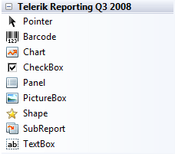
REPORT ITEMS
8 report items in the toolbox

Slide 5
DEMOS!

Slide 6
LOOKING AHEAD
Mail Merge
HTML TextBox
Report Book
Cross-tab Support
Q1 2009 release soon!!!

Slide 7
QUESTIONS?
blogs.telerik.com/kevinbabcock
tv.telerik.com

