Slide 1
Silverlight Development Best Practices
Evan Hutnick
Evan.Hutnick@Telerik.com
Notes:
Silverlight Development Best Practices In this session, we will explore best practices of development with Silverlight. This will include a look at the current toolset (VS2010/Blend) as well as the different options for architecture and data access (to MVVM or not to MVVM, WCF RIA Services or not, etc.), as well as how you can structure your application for intelligent reuse of styles and resources, making it easier to design a large-scale application with a unified look and feel.

Slide 2
Session Roadmap
Introduction
Silverlight Foundation
The Tools of Silverlight
Layout
Databinding
Data Access
Styles and Resources
Project Architecture
Putting this all together
Wrap-up

Slide 3
Introductions
Who am I?
Evan Hutnick
Developer Evangelist for SL/WPF @ Telerik
XAML Geek
WP7 Geek {BasedOn XamlGeekStatus}
@EvanHutnick
http://blogs.telerik.com/evanhutnick

Slide 4
Introductions
Telerik
Started in 2002 with 1 control
Began with UI, now a .Net ‘Toolbox’ vendor
Providing tools for end-to-end development of projects
Developer Productivity
Automated* Testing
Web Content Management
Team Productivity
@Telerik
http://www.facebook.com/Telerik

Slide 5
Silverlight Foundation
What we’re used to:
What is new:
UI Designer
Events and code-behind
Basic controls (text block, textbox, etc.)
Layout mechanism
Custom control development*
Rich binding infrastructure
Fast iterations in SL versions*
Data templates
“Lookless” controls
Webcam/Microphone API, drop target, interop…

Slide 6
The Tools of Silverlight
Visual Studio 2008 2010
Visual Designer (not just visual representation)
Document Outline
DataContext Window
Data Sources Window
Drag and drop databinding (think WCF Ria Services here)
I’m really ready for Silverlight now!

Slide 7
The Tools of Silverlight (Part 2)
Expression Blend
Visual Designer
Animation/storyboarding support
Drag and drop enhanced (think Behaviors)
Expression Design
Xaml designer
Exports in a format usable by Blend/VS
Great stepping stone for Illustrator/ Photoshop expatriates

Slide 8
Layout
Three main options:
Canvas
StackPanel
Grid
What are the benefits of each?
When should I use panel X?
What about the Border? Doesn’t that contain content?

Slide 9
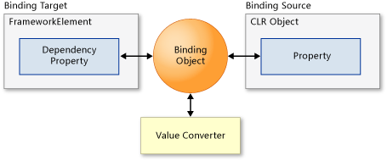
Databinding
The DataContext
{Binding …}
With ElementName
With Path
With Converter
With BindingBase
What this lets us do (hint, it rhymes with Emvee Vee’em)

Slide 10
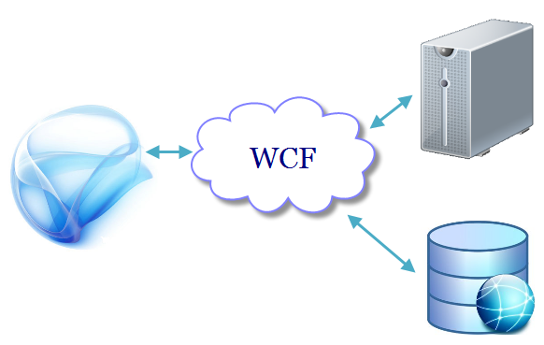
Data Access
Javascript bridge to DOM
Socket Connection
Proxy generation
Client-Server contract
WCF Services
No, not full WCF Services
WCF RIA Services
Easier client/server interaction
DomainDataSource
Validation model built-in

Slide 11
Styles and Resources
Where we can store resources
*Control.Resources
UserControl.Resources
App.Xaml
Resource Dictionaries
When to re-use, when not to
Implicit styling

Slide 12
Project Architecture
Ways to structure your project:
Single application
Everything is in one place
Single App.Xaml for application-wide styles*
Everything references everything else, all you need is the right usings / namespace declarations
Modular application
Separate ‘modules’ for different sections of the application
Separation of concerns… under one solution

Slide 13
Project Architecture (p2)
Model
ViewModel
View
Still able to reference items from modules
Semi-loosely coupled
Reference dictionaries to clean up styling
MVVM
Holy grail of SL/WPF development?
Very loosely coupled, encourages modular development best practices
Viewmodel vs. code-behind
Extra frameworks required

Slide 14
Putting It All Together
Understanding the tools, the framework, and the development options that we have available is what dictates a
well defined, well developed,
and maintainable application.

Slide 15
Wrap-up
Make everything you can re-usable (core object oriented idea here)
Know the benefits of the layout system as well as which panel you need for the job
Make it Blend – your designer will thank you
Understand databinding – your application architecture will thank you
Know when to utilize *Control.Resources, App.Xaml, and Resource Dictionaries
And then some helpful resources…

Slide 16
Names to Know
Pete Brown
John Papa
Gill Cleeren
Laurent Duveau
Shawn Wildermuth
Wynapse (Google it, you’ll find Dave ☺)
Emil Stoychev (Silverlightshow.net)

Slide 17
TechDays Canada
Awesome lineup of speakers
I’ll be in Edmonton, Ottawa, and Calgary ☺
Free TechNet Subscription
Free Telerik RadControls for Silverlight Developer License
Early-bird pricing still available for most cities!
http://www.techdays.ca

Slide 18
Thanks!

