Slide 1
OpenAccess ORM
Advanced Topics
Kevin Babcock
April 9, 2009

Slide 2
Agenda
OpenAccess ORM Overview
Inheritance & Polymorphism
Transactions
Fetch Plans & Fetch Groups
Wrap Up

Slide 3
OpenAccess ORM Overview
Object/Relational Mapper
Bridge the gap → database | application code
Forward Mapping
Map classes to tables
Reverse Mapping
Map tables to classes
LINQ
Perform LINQ queries with OpenAccess

Slide 4
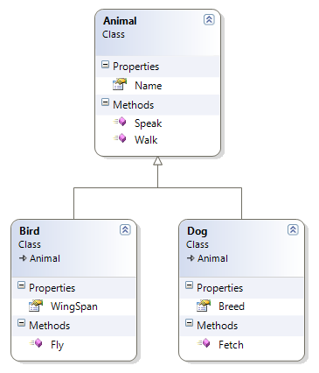
Inheritance & Polymorphism
Inheritance
Extend the functionality of existing classes with
inherited classes
Bird parrot = new Bird();
parrot.Name = “Polly”;
parrot.WingSpan = “12”;
parrot.Speak();
parrot.Walk();
parrot.Fly();

Slide 5
Inheritance & Polymorphism
Inheritance - 4 supported “scenarios”
Flat Mapping
Vertical Mapping
Mixed (Flat & Vertical) Mapping
Horizontal Mapping
*The default mapping strategy is Flat Mapping

Slide 6
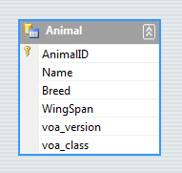
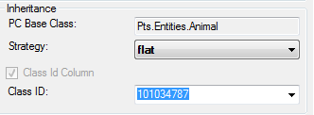
Inheritance & Polymorphism
Inheritance – Flat Mapping [default setting]
All properties from subclasses are mapped to a single table
Requires a discriminator column to identify each row
Advantages:
No extra joins required
Only one INSERT/UPDATE/DELETE required
Disadvantages:
Extra columns that aren’t always used
An extra “discriminator” column

Slide 7
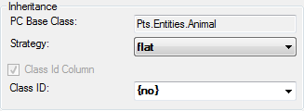
Inheritance & Polymorphism
Inheritance – Flat Mapping [default setting]
Discriminator Column
Named voa_class
Type is INTEGER, unless another class in the hierarchy has a
ClassID other than INTEGER
If each class in the hierarchy has at most one subclass, the
discriminator column can be disabled
Set the ClassID to {no}

Slide 8
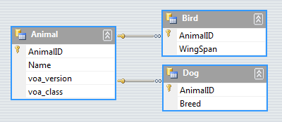
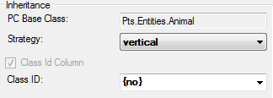
Inheritance & Polymorphism
Inheritance – Vertical Mapping
Each class has its own table containing only its fields
Advantages:
Normalization
Subclasses can be added easily
No discriminator column required
Disadvantages:
Multiple joins must be used
Multiple INSERT/UPDATE/DELETE
statements required for database changes

Slide 9
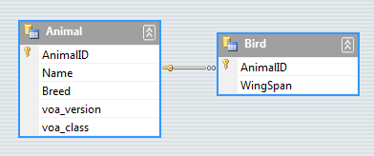
Inheritance & Polymorphism
Inheritance – Mixed (Flat & Vertical) Mapping
The mapping strategy is set on a per-class basis, so any combination can be used to map inherited classes.
Strategies can be “tweaked” in order to maximize performance and database space usage

Slide 10
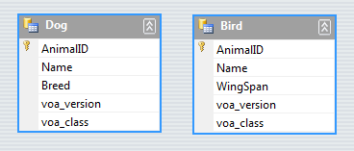
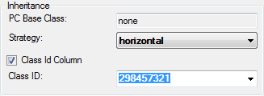
Inheritance & Polymorphism
Inheritance – Horizontal Mapping
Can only be enabled for the topmost class in a hierarchy
The superclass is not represented in the database, and should
be marked as abstract.
Advantages:
As fast as Flat Mapping
No joins required
Common attributes defined in superclass
Disadvantages:
Each derived class starts a new hierarchy
De-normalized database
Querying the topmost class is expensive

Slide 11
Inheritance & Polymorphism
Polymorphism aka “late-binding”
Allows values of different data types to be handled
using a uniform interface
Animal animal = new Dog();
animal.Speak(); // returns "Bark"
animal = new Bird();
animal.Speak(); // return “Chirp"

Slide 12
DEMO

Slide 13
Transactions
Transactions control the concurrent access of data by multiple programs.
OpenAccess ORM maintains transactional consistency in the database by adhering to the ACID principles:
Atomicity, Consistency, Isolation, Durability

Slide 14
Transactions
Atomicity: changes to the values in persistent states are either executed in their entirety or not at all.
If one part of the transaction fails, the entire transaction fails
Consistency: the state of the database must remain consistent before and after a transaction
If the transaction fails, the rollback must reestablish the
consistent state of the database

Slide 15
Transactions
Isolation: changes to values in persistent instances are isolated from changes to the same instance in other transactions
Transactions should appear to be running independently
from other transactions
Durability: transactions committed to the database will not be lost
This is guaranteed by the database backend

Slide 16
Transactions
When using OpenAccess ORM, the following operations require a transaction:
Reading persistent objects from the database
Inserting new persistent objects into the database
Modifying existing objects in the database
Deletion of objects from the database

Slide 17
Transactions
Operations for a transaction are accessible through
the ITransaction interface
Obtained from IObjectScope.Transaction
IObjectScope scope =
ObjectScopeProvider.GetNewObjectScope();
scope.Transaction.Begin();
Customer customer = new Customer();
customer.Name = “John Doe”;
scope.Add(customer);
scope.Transaction.Commit();

Slide 18
Transactions
If you decide that you no longer wish to persist the
changes to the database, you can rollback the
transaction.
scope.Transaction.Begin();
Customer customer = new Customer();
customer.Name = “John Doe”;
scope.Add(customer);
// perform some logic here
scope.Transaction.Rollback();

Slide 19
Transactions
IObjectScope.TransactionProperties
RetainValues [true] – controls whether objects retain
their values after commit of the transaction
RestoreValues [false] – controls whether the values of
persistent objects are restored to their originals when a
transaction is rolled back
AutomaticBegin [false] – automatically restarts a new
transaction after every commit and rollback
FailFast [true] – determines whether a transaction
commit or flush should fail at the first failure

Slide 20
DEMO

Slide 21
Fetch Plans & Fetch Groups
Allow you to specify which fields are retrieved from
the database
Results in more optimized database queries
FetchGroups
Used to mark fields for each class
Used to indicate field recursion-depth
Can be used with one or more classes
FetchGroup names have a global scope

Slide 22
Fetch Plans & Fetch Groups
FetchPlans
Consists of one or more FetchGroups
FetchGroups are combined additively
Default FetchGroup
Created for each class
Retrieves fields of basic type or single-reference type
only the ID of the referenced object will be retrieved

Slide 23
Fetch Plans & Fetch Groups
Defining FetchGroups
In code [default]:
[Persistent] public class Employee { [FetchField("FG_empName")] private string firstname; [FetchField("FG_empName")] private string lastname; }
In the config file:
<class name="Employee"> <fetch-group name="FG_empName"> <field name="firstname"/> <field name="lastname"/> </fetch-group> </class>

Slide 24
DEMO

Slide 25
Wrap Up
OpenAccess ORM Overview
Inheritance & Polymorphism
Transactions
Fetch Plans & Fetch Groups

Slide 26
Questions ???
blogs.telerik.com\kevinbabcock
tv.telerik.com

