Slide 1
Fiddler & GeoEdge
Worldwide Testing from your Desktop
Amnon Siev – CEO of GeoEdge
Eric Lawrence – Developer of Fiddler
May 14, 2014
Notes:
Worldwide Testing from your Desktop: Fiddler & GeoEdge
It’s called the worldwide web for a reason—your site probably gets visitors from all over the world. But are they having the great experience you expect? With the new GeoEdge plugin integrated into Fiddler, you can test your sites and web applications through any of over 130 worldwide endpoints, ensuring that your performance is great and your content is properly geo-targeted for your visitors. In this webinar, we’ll introduce the GeoEdge worldwide proxy network, and show quick demos of how you can begin worldwide testing of your applications using Fiddler & GeoEdge.

Slide 2
Today’s Agenda
Geo-targeting and Fiddler
Introduction to GeoEdge
Demo
Try it today, for free
Q&A

Slide 3
Geo-testing
Local User-Experiences
Ad-targeting
Worldwide Performance

Slide 4
About GeoEdge
Leading provider of ad verification and visibility solutions for the online and mobile advertising ecosystem.
Key Services:
Automated Ad Verification: Monitor and Enforce ad quality and compliance on a global scale.
Premium Proxy Service: The world’s largest, fastest and most reliable premium proxy and VPN network. Proprietary servers deployed in over 130 geo-locations.
Selected customers include:

Slide 5
Premium Proxy Network
High-performance servers | Fast with high connection-capacity
True geo-located IPs | Servers physically located all over the world and are validated via industry leading geo-location databases (e.g. Maxmind, Quova etc.)
Unmasked | by Google/ AppNexus/Yahoo/Yandex and other leading players in the online advertising space
Committed to privacy | Secure and protected server farms
Unmatched reliability | 99.9% network uptime, with ongoing QoS monitoring
Protocols | HTTP / HTTPS VPN – Open VPN PPTP

Slide 6
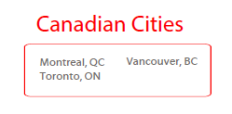
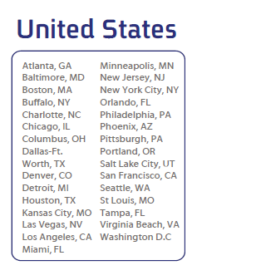
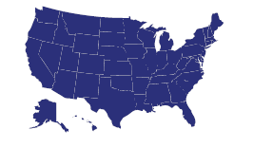
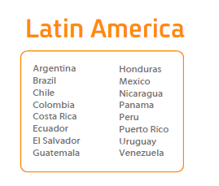
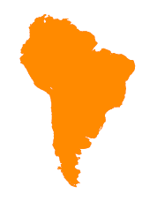
More than 130 global locations… and still growing!!

Slide 7
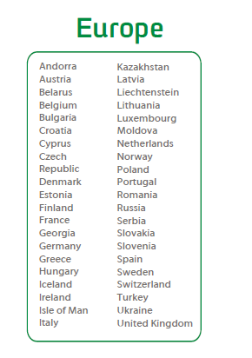
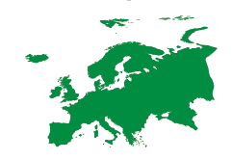
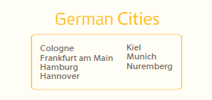
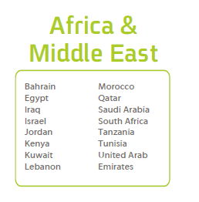
More than 130 global locations… and still growing!!

Slide 8
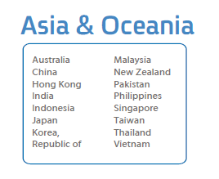
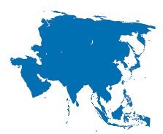
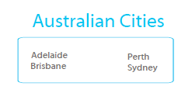
More than 130 global locations… and still growing!!

Slide 9
Demo
Notes:
Try it today – There’s nothing to install, you get a free 5 day trial, and you can run from ~77 “non-premium” locations worldwide.

Slide 10
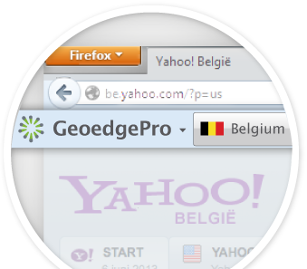
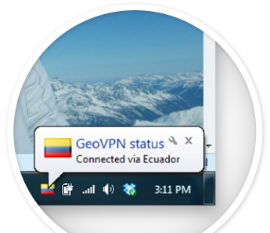
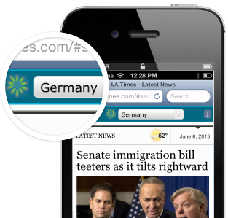
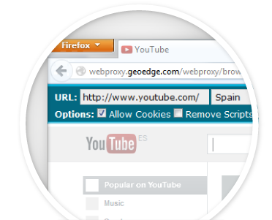
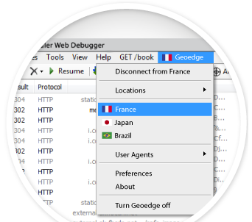
GeoEdge offers a wide variety of tools….
New! Telerik Fiddler Integration
Mobile Apps (Android and iOS)
VPN Client (Windows, Mac, Linux)
Browser Toolbars (Firefox and Chrome)
RapidVPN Service
Web Proxy
API Service
So much more than just a proxy!

Slide 11
Q&A
We’ll take questions from the Webinar Chat Window
Talk to us on Twitter @TelerikFiddler and @GeoEdgePro
eric.lawrence@telerik.com / @ericlaw
Thanks!

Slide 12
Backup Slides

Slide 13
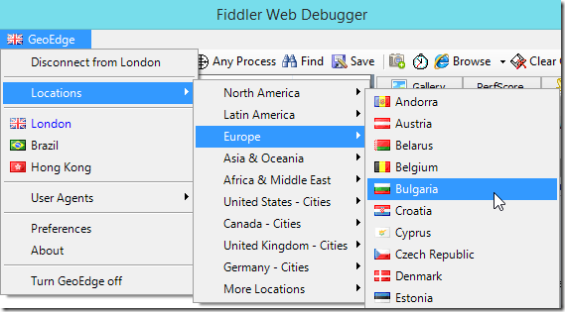

Slide 14
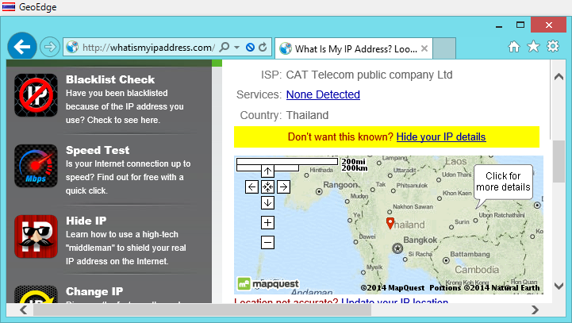
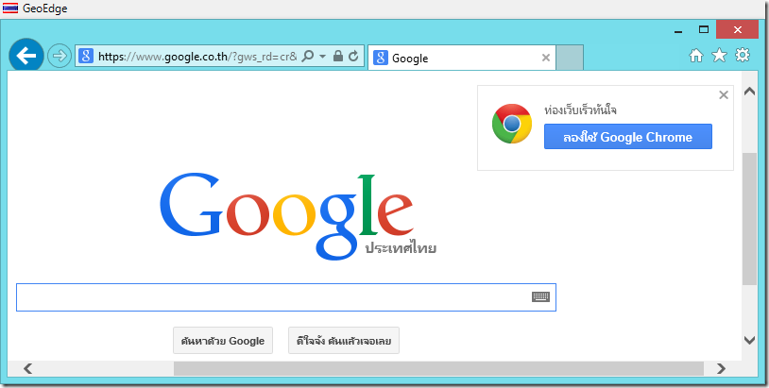
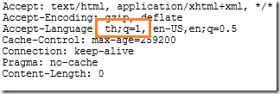

Slide 15
