Slide 1
Telerik UI for Windows Universal
Brand New for Q3 2014
Oct 29, 2014

Slide 2
Introducing - Telerik UI for Windows Universal
Samidip Basu Developer Advocate | Telerik Inc. | www.telerik.com
E: Sam.Basu@Telerik.com |T: @samidip | W: http://samidipbasu.com

Slide 3
Why Universal Apps?
We’re living Mobile First, Cloud First
Microsoft rolled out Windows Phone 8.1
Along came Windows 8.1
And, Windows 10 was announced
Terrific time to be a Microsoft developer!
We’re chasing the “Write once, Run everywhere” dream
Convergence of platforms .. Desired single code-base
Updated Windows Runtime – underlying framework
Universal apps run seamlessly in Windows & Windows Phone!

Slide 4
Telerik UI for Windows Universal
We had UI for Windows Phone (XAML in Silverlight Runtime)
We had UI for Windows 8 (XAML & HTML)
Now introducing UI for Windows Universal!
Free upgrade, if you had UI for Windows 8
Just like Microsoft, our UI control suites are converging
Single set of UI components powering Windows Store & Windows Phone apps
Re-engineered native controls for Windows Runtime
Adaptive Rendering across form factors
Uncompromising performance
Let’s build the next generation of awesome Windows apps together!

Slide 5
AutoCompleteBox
Make typing fun for end-users
Bing/Google like suggestions
Suggestions in pop-up or listbox
Easy data bindings – local or remote
Personalized item templates for look & feel
Customizable configurations
Fast & fluid performance
Product page: http://www.telerik.com/windows­universal­ui/autocompletebox

Slide 6
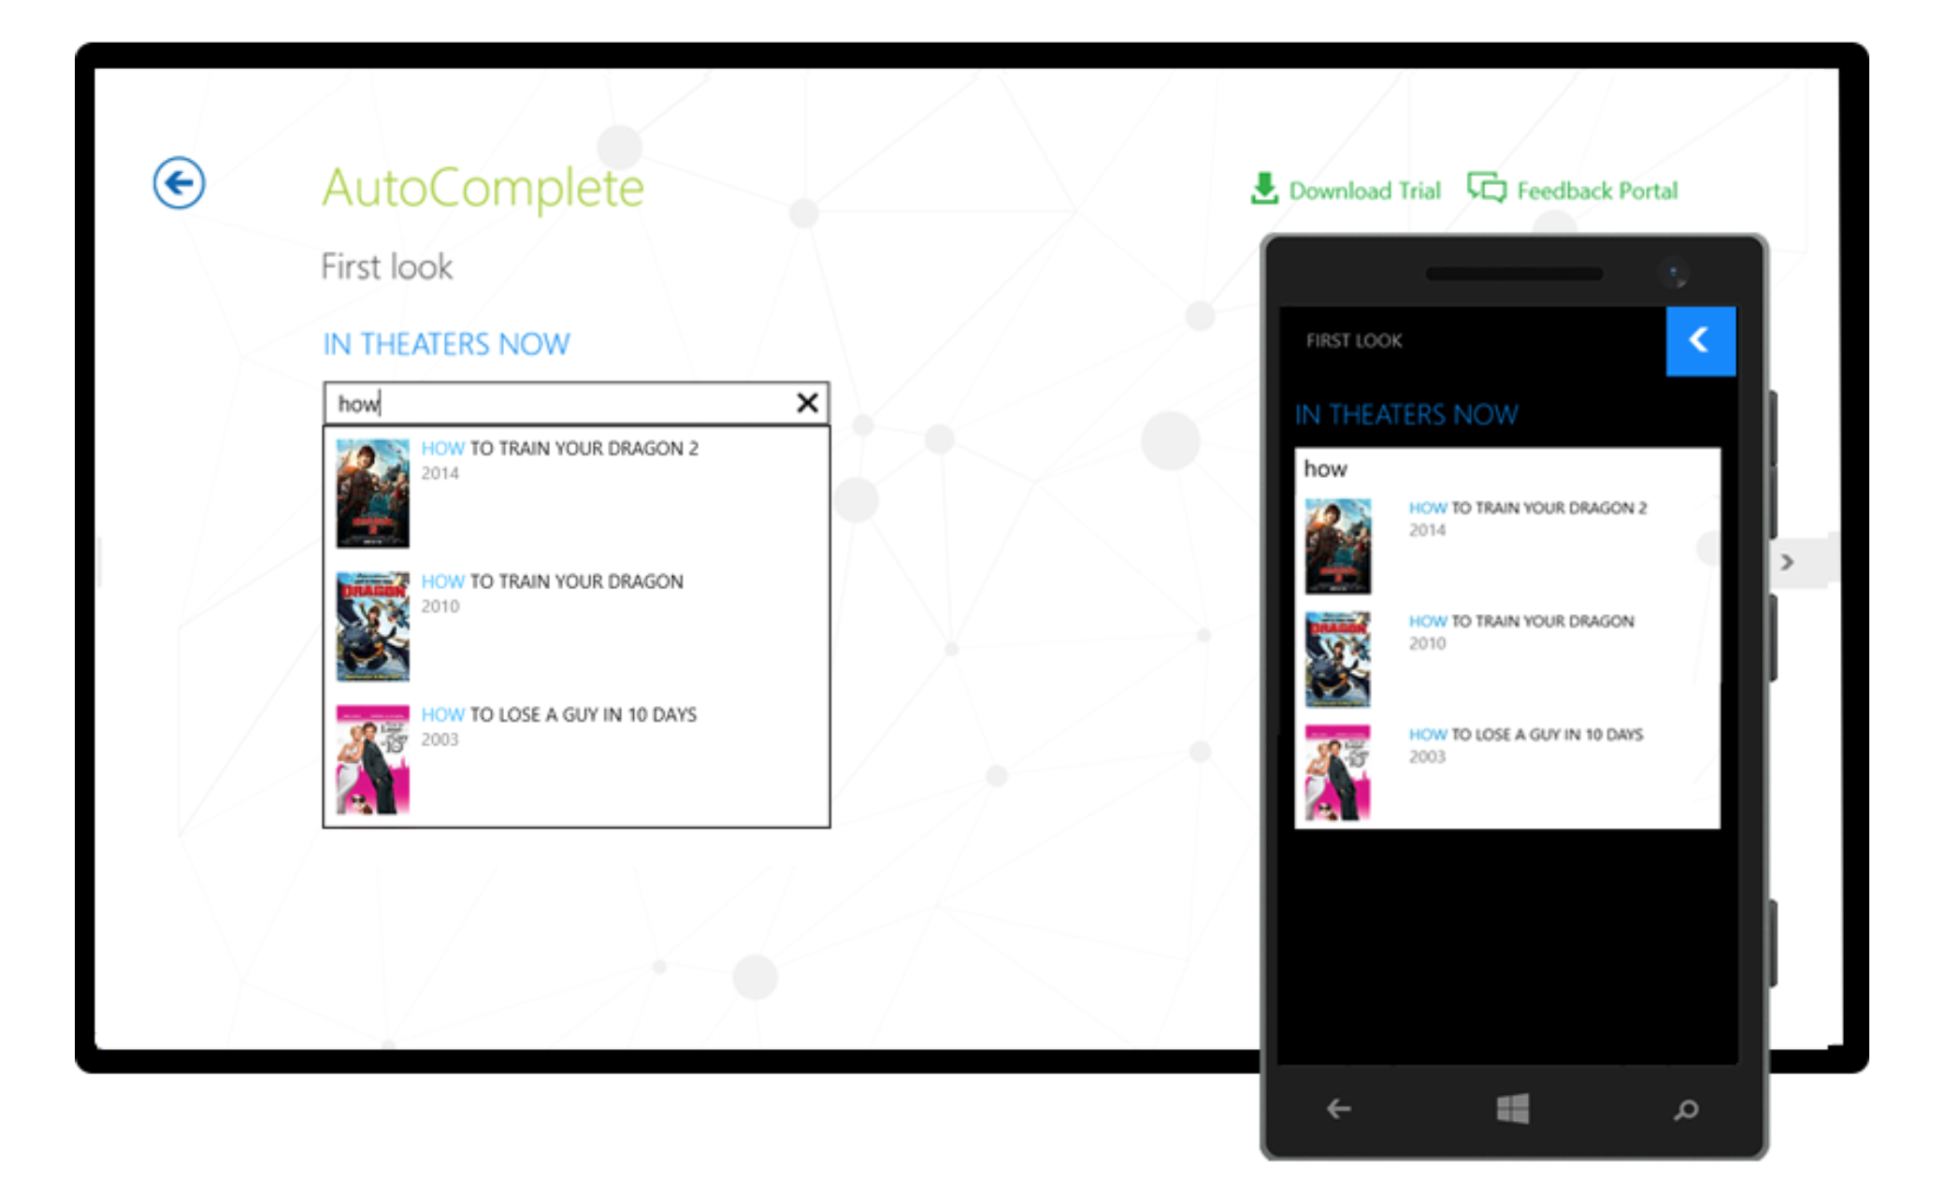
AutoCompleteBox

Slide 7
BusyIndicator
Clearly indicate long operations to users
Variety of pre-defined animation styles
Custom text & position for indicators
Fine-tunable behaviors
Product page: http://www.telerik.com/windows­universal­ui/busyindicator

Slide 8
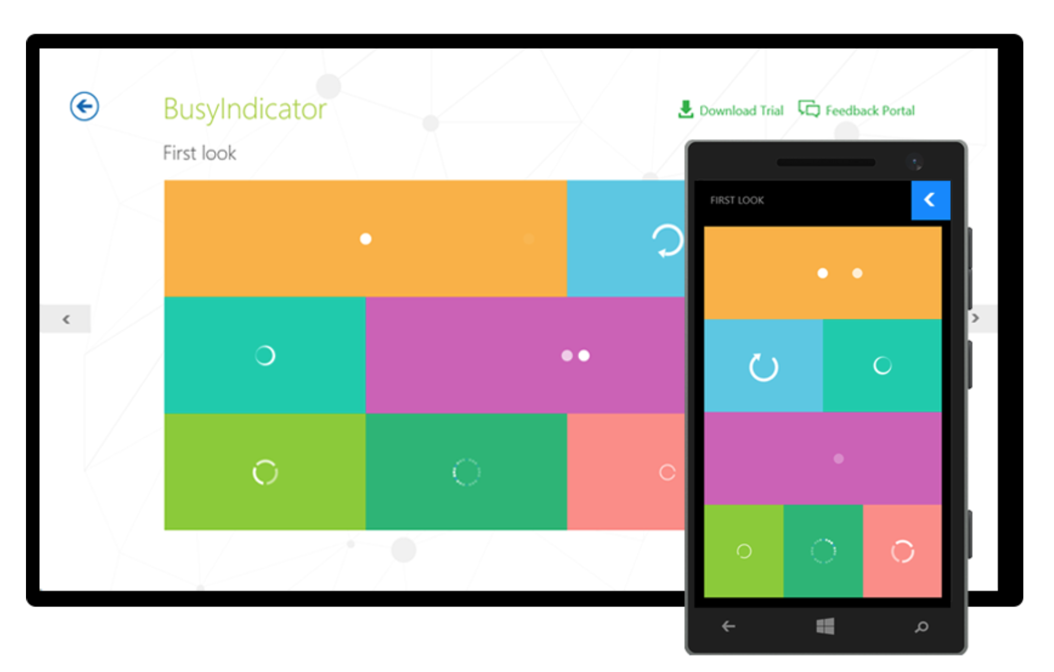
BusyIndicator

Slide 9
Calendar
Appointments aware – easy API to add/remove
Culture aware – device or specific
Just about every UI component is configurable
Reimagined for touch & gestures on Windows Phone/Store apps
Fast & intuitive navigation – month/year/decade views
Single or Multiple date selections
Special days & custom events – personalized UI
Product page: http://www.telerik.com/windows­8/calendar­xaml

Slide 10
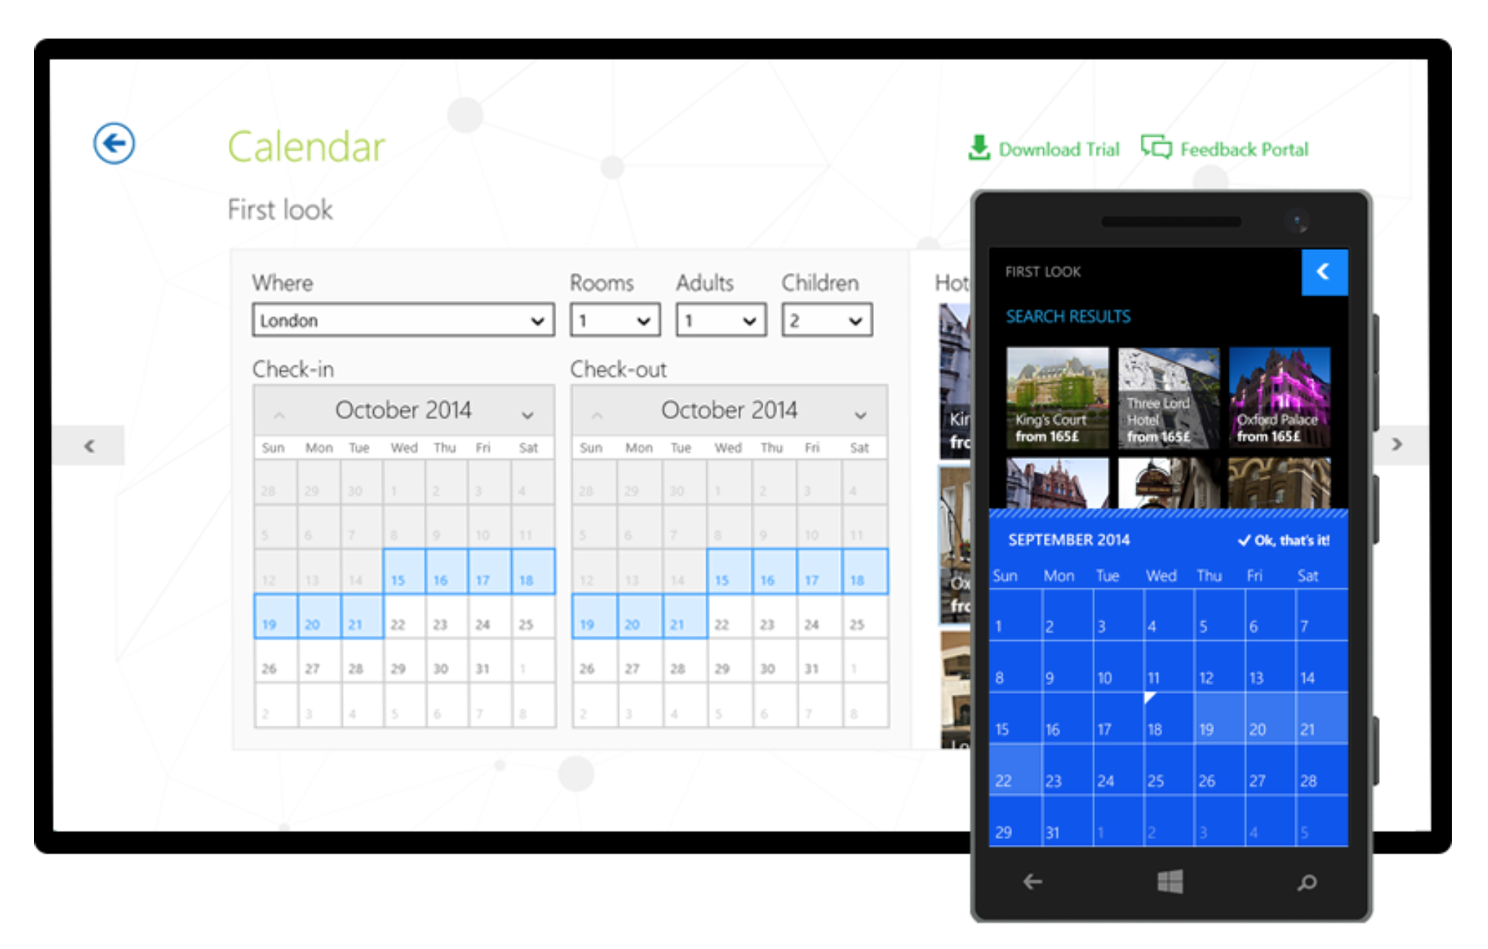
Calendar

Slide 11
Charts
Richest suite of charting controls for Universal apps
Huge variety of charts – Bar/Line/Area/Pie/Scatter/Polar etc.
Support for financial series – Candle & OHLC (Open High Low Close)
Visualize multiple data series in single chart – Multi axis support
Optimized performance – fast loading, pixel perfect & excellent drawing capabilities
Custom annotations – visual elements to attach to specific data points
Full touch interactivity – Pan/Scroll/Zoom/Pinch
Product page: http://www.telerik.com/windows­universal­ui/chart

Slide 12
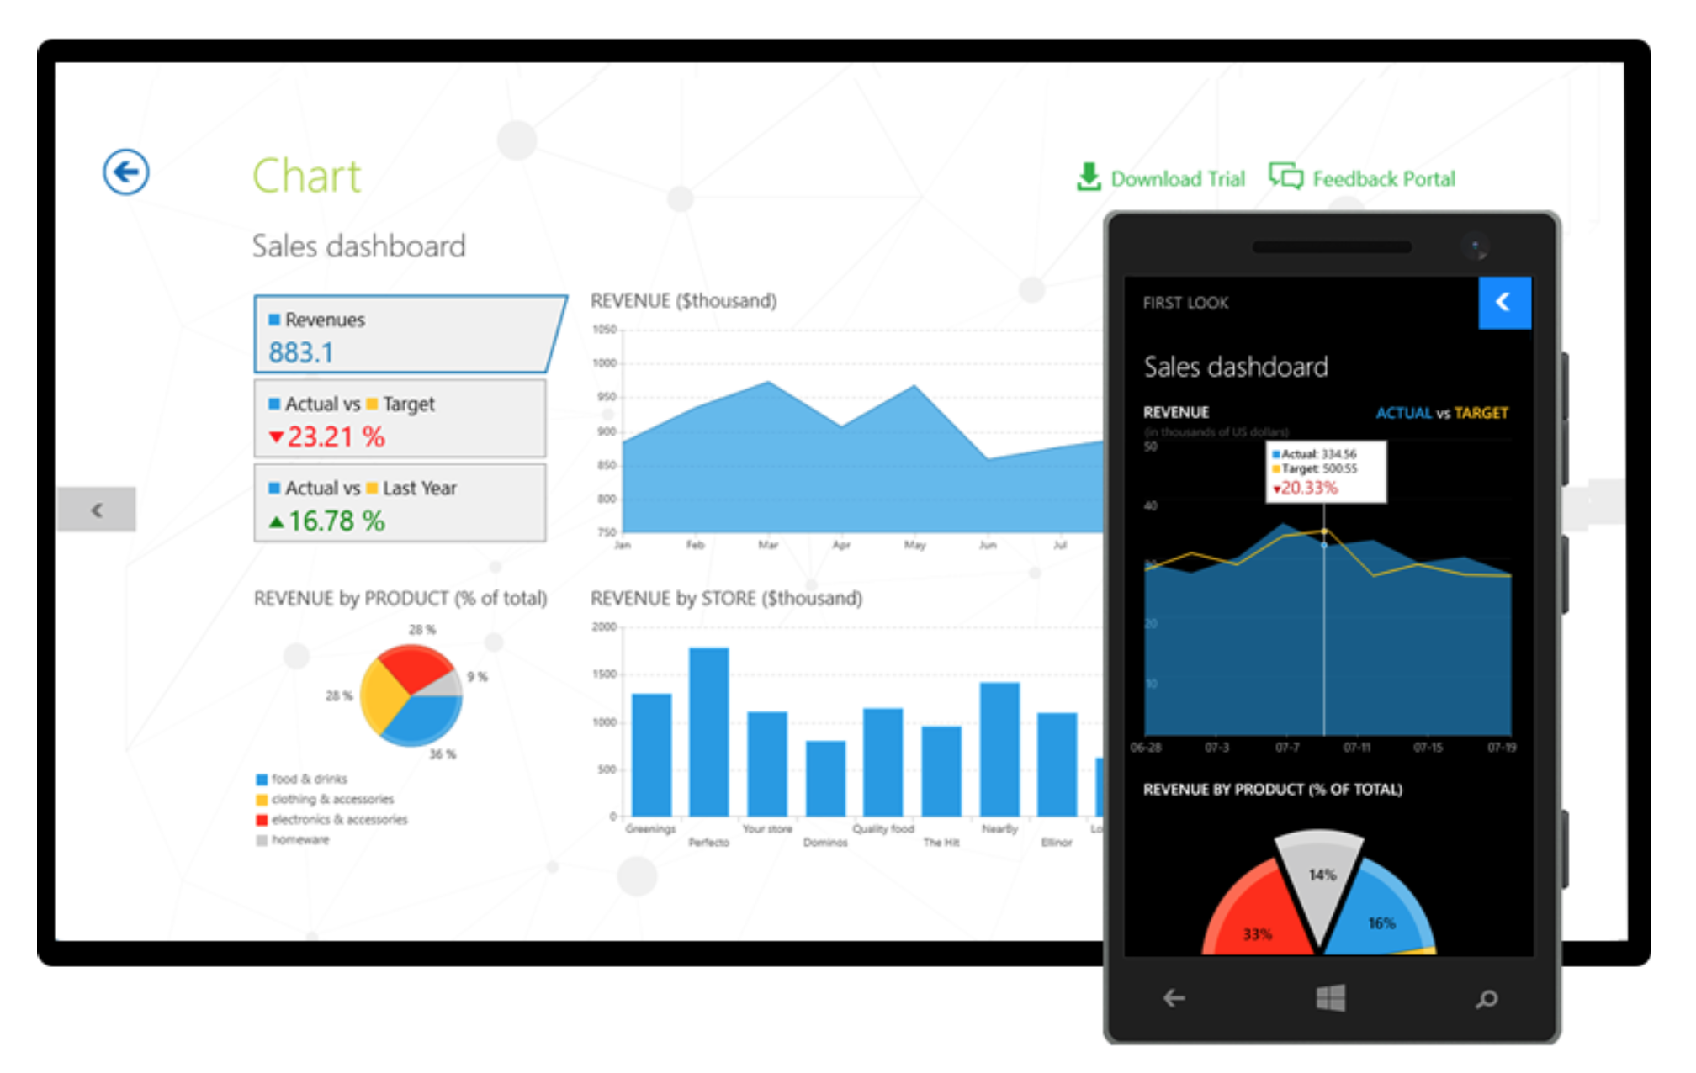
Charts

Slide 13
DataBoundListBox
Every mobile app needs one
DataBoundListBox for Universal apps sports terrific performance
Three modes of data virtualization – Automatic, OnDemandManual & OnDemandAutomatic
Easy data bindings – local or remote
Header & Footer support
Per item animations – on addition or removal
Pull to Refresh
Product page: http://www.telerik.com/windows­universal­ui/databoundlistbox

Slide 14
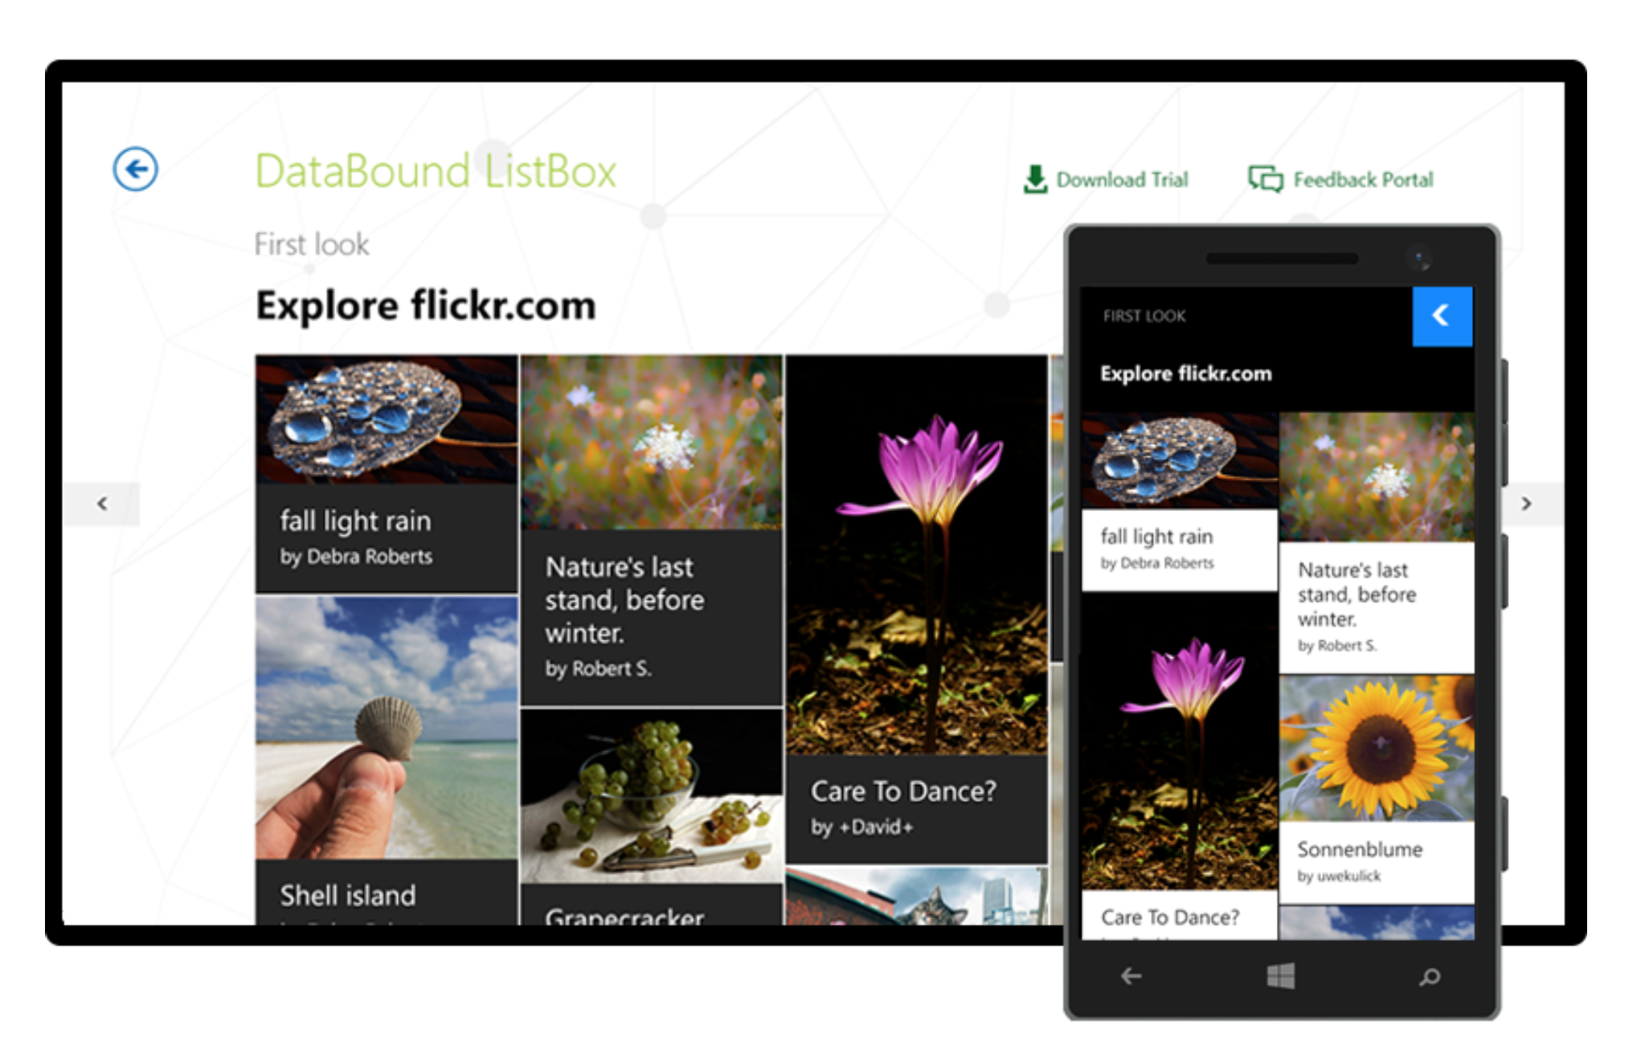
DataBoundListBox

Slide 15
DatePicker
Easy date picker for various form factors
Intuitive selection of date, month & year
Infinite looping on all three elements
Customization capabilities – various formats & date ranges
Culture aware – device or specific
Product page: http://www.telerik.com/windows­universal­ui/datepicker

Slide 16
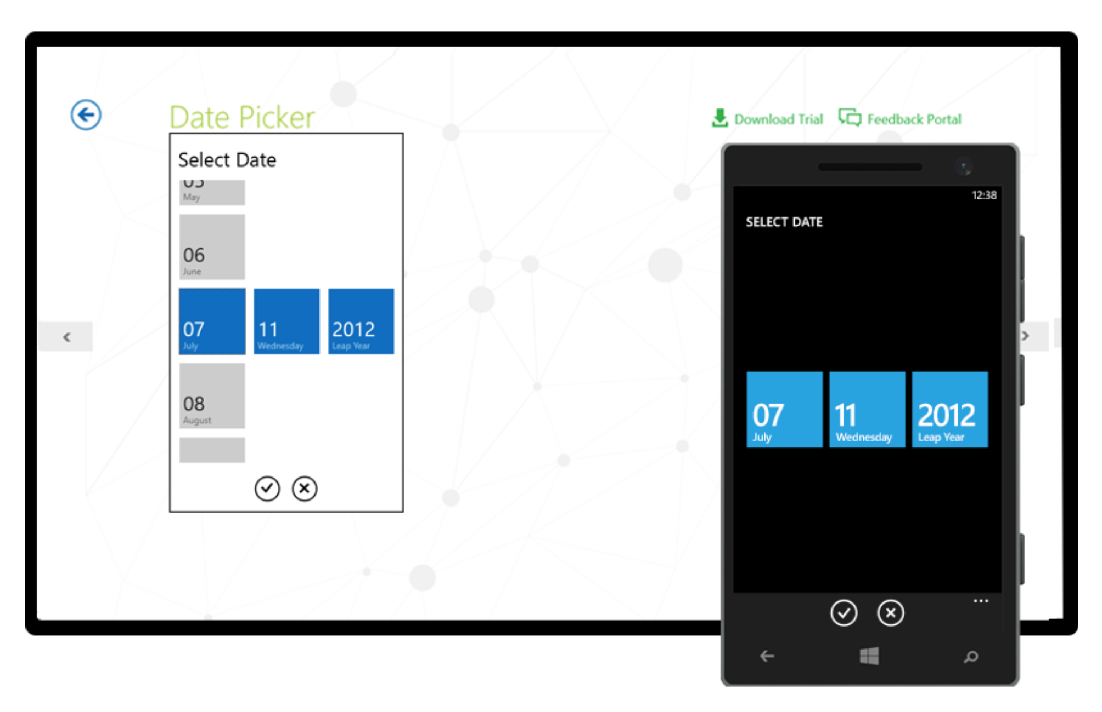
DatePicker

Slide 17
TimePicker
Easy time picker for various form factors
Intuitive selection of hour & minute
Infinite looping on both elements
Custom time intervals – formats & time ranges
Culture aware – device or specific
Product page: http://www.telerik.com/windows­universal­ui/timepicker

Slide 18
HubTile
Bring Windows-style tiles to your Universal apps
Rich tiles for unique style & native navigation
Diverse tile types – rotating, sliding or mosaic
Data binding – for front & back of tiles
Live tiles – rotate or slide new content
Product page: http://www.telerik.com/windows­8/hubtile­xaml

Slide 19
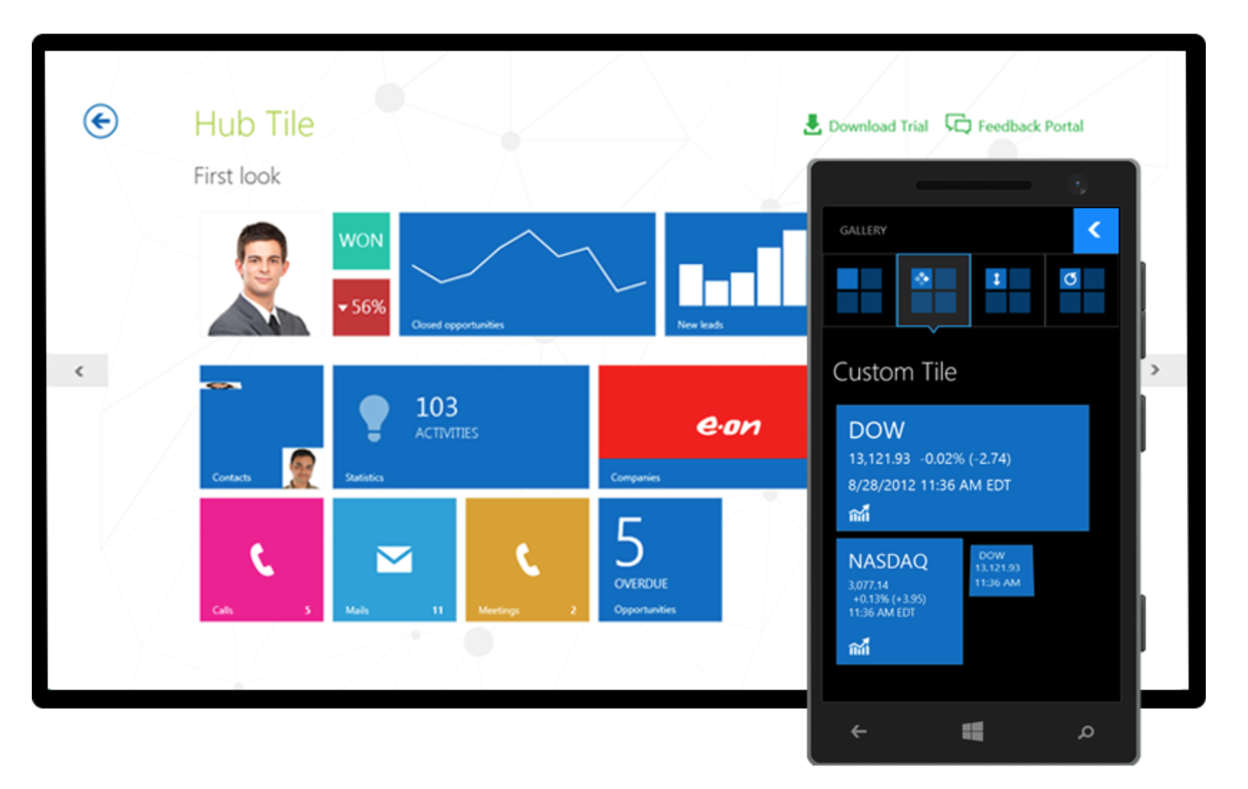
HubTile

Slide 20
Rating
Helps build user interactivity through easy Ratings
Customizable shapes
Display precision – visualize fractions of items
Customizable display orientations
Product page: http://www.telerik.com/windows­universal­ui/rating

Slide 21
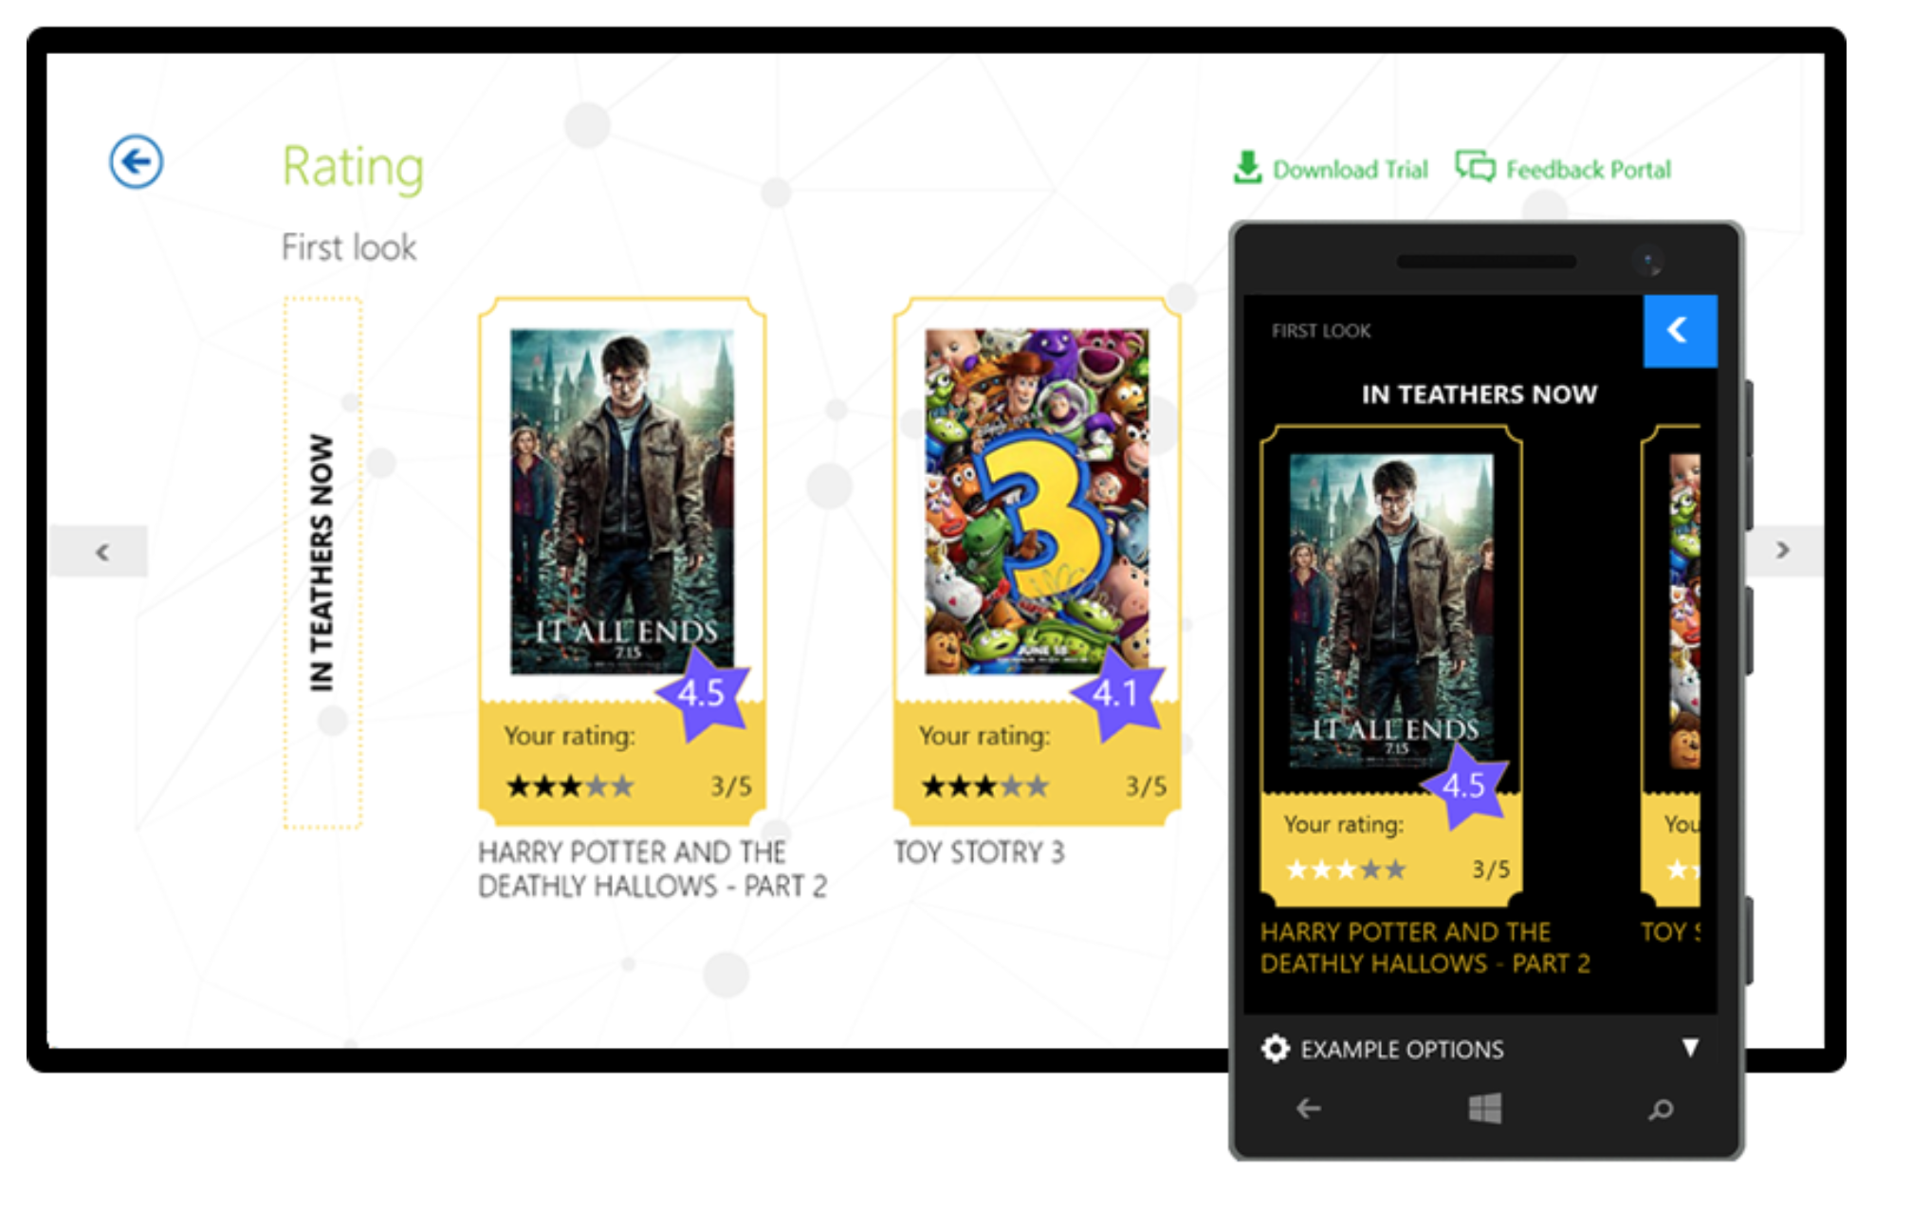
Rating

Slide 22
Let’s dive into Telerik UI for Windows Universal
Build the next-gen amazing Windows Apps!

Slide 23
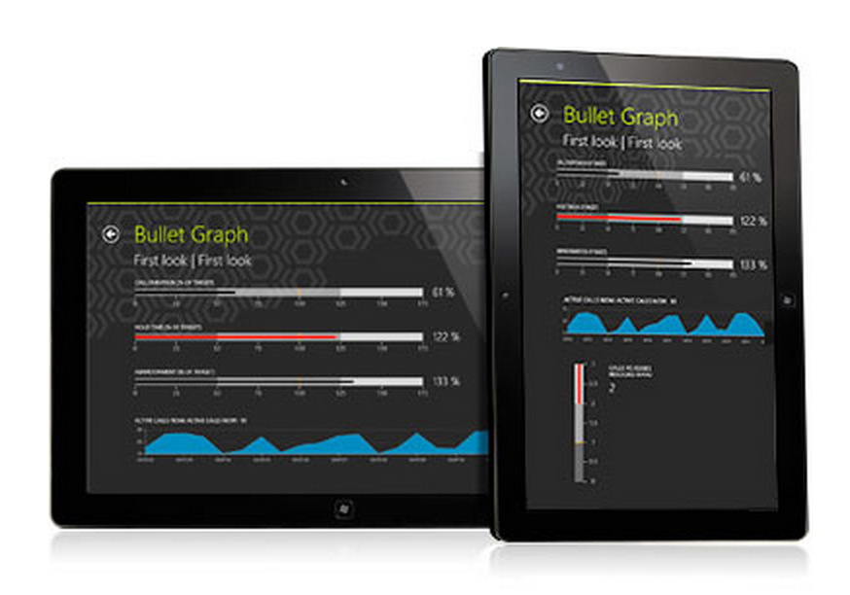
BulletGraph
Windows 8.1 exclusive
Helps visualize progress
Horizontal/Vertical support
Easy comparisons of projected & featured values
Instant access to overall progress of a task/process
Product page: http://www.telerik.com/windows­8/bulletgraph­xaml

Slide 24
DataGrid
Windows 8.1 exclusive
Native, rich & powerful data grid
Telerik DataGrid written from scratch to optimize for touch
Smart UI virtualization for responsiveness
Customizable cells – templates to accommodate any types of data
ComboBox columns – displays sets of predefined values
Built-in DataStorage Provider – SQLite wrapper with ORM & Lync
Support for Sorting, Grouping, Filtering & Selections
In-place data edits for cells
Product page: http://www.telerik.com/windows­8/grid­xaml

Slide 25
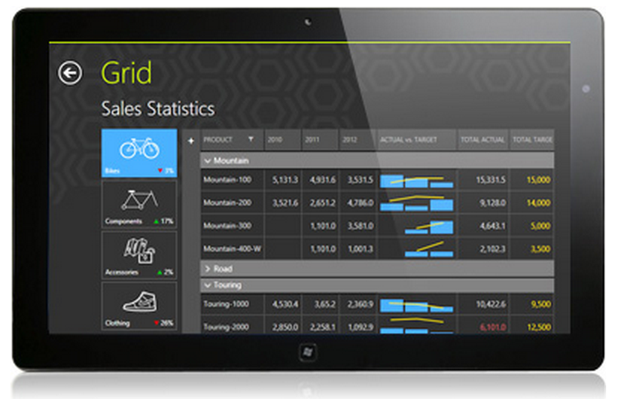
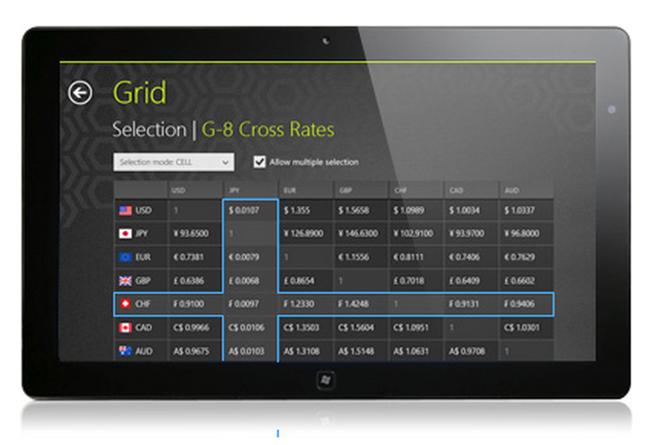
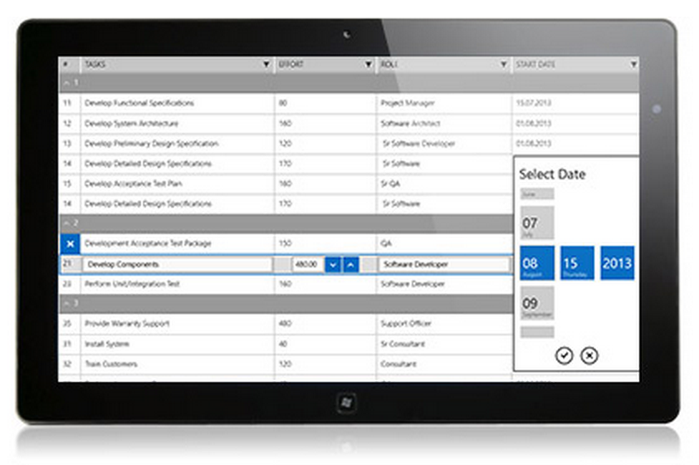
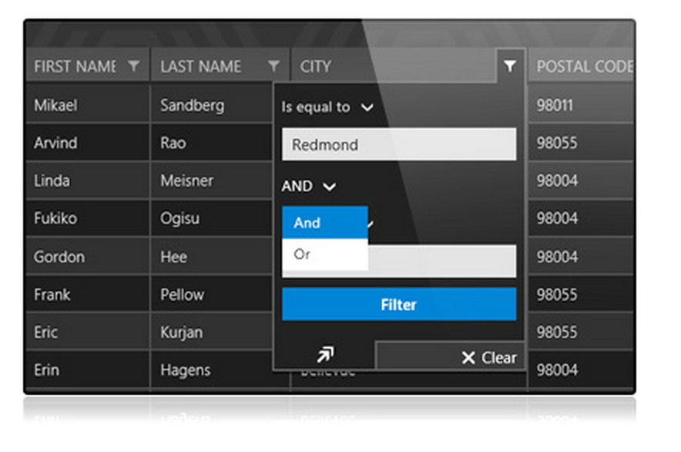
DataGrid

Slide 26
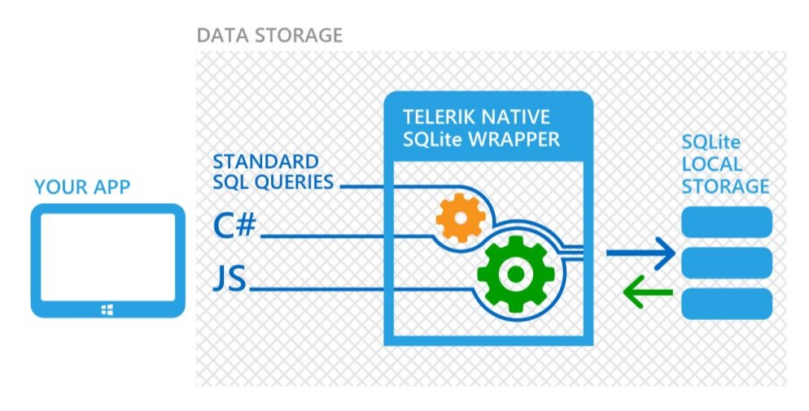
DataStorage
Windows 8.1 exclusive
Local storage made easy – uses SQLite under covers
No complexity for developers
Great for offline data stowage
C# or SQL queries
Easy CRUD operations
Product page: http://www.telerik.com/windows­8/datastorage­xaml

Slide 27
Map
Windows 8.1 exclusive
Rich spatial data with full touch support
Native Diret2D rendering for ultimate performance
ESRI Shapefile support – popular geopspatial vector data format
Custom shapefile support – floorplans, seating maps etc.
Optimized for minimum memory footprint – can render thousands of shapes
Shapes layer + User layer – support for custom data on top of shapefiles
Customizable appearance through color palettes
Product page: http://www.telerik.com/windows­8/map­xaml

Slide 28
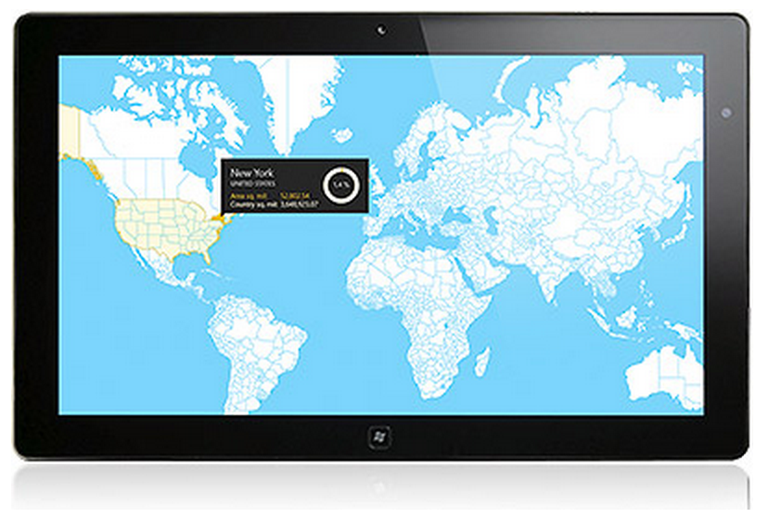
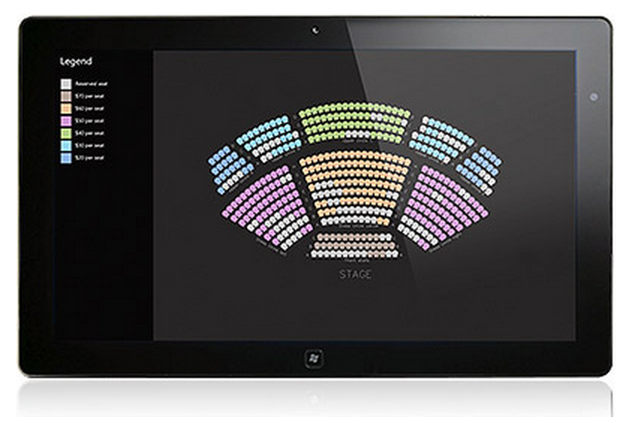
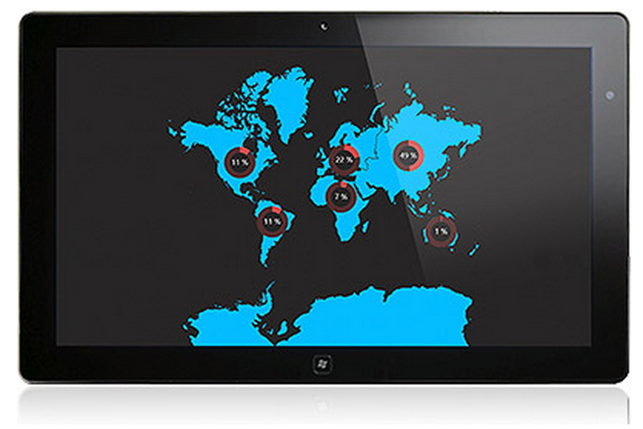
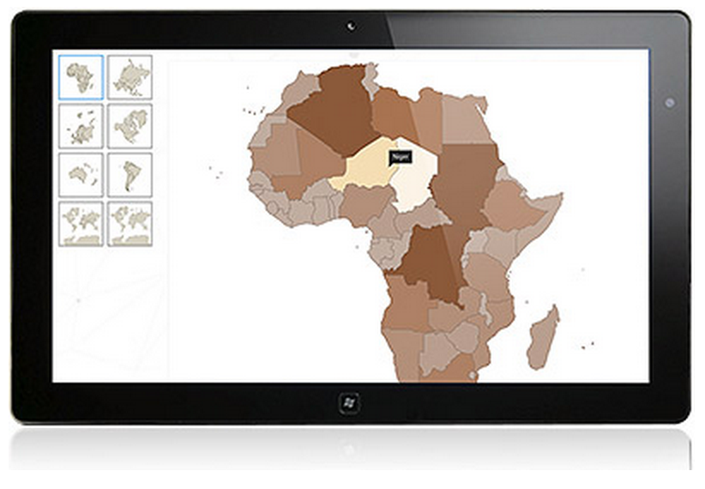
Map

Slide 29
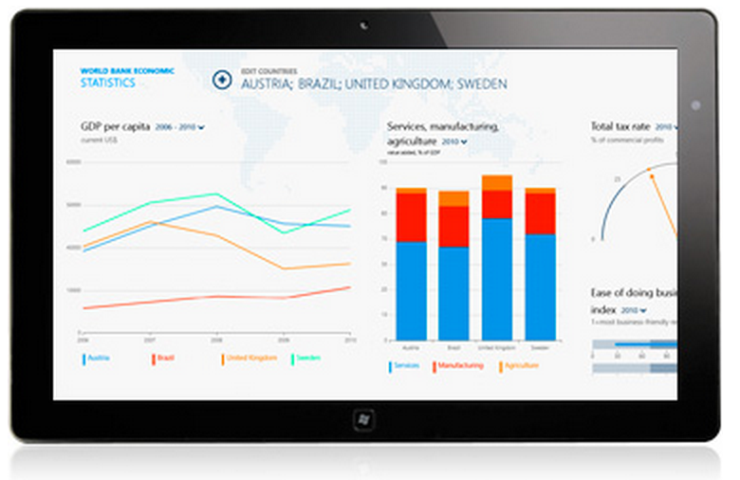
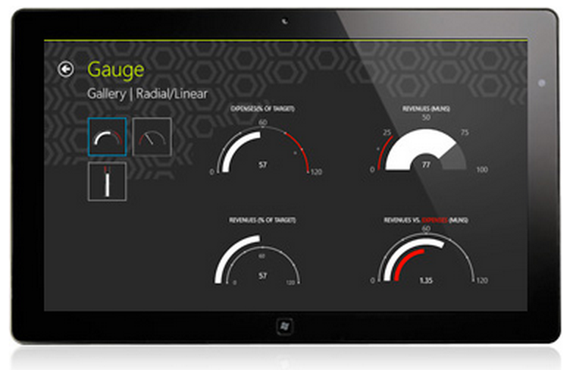
Gauge
Windows 8.1 exclusive
Rich but easy gauge indicators for your Windows apps
Great for dashboard-type visuals
Radial gauges – circular scale with numbers & ticks
Linear gauges – linear scale with ranges
Variety of indicators & rich animations built-in
Customizable properties
Product page: http://www.telerik.com/windows­8/gauge­xaml

Slide 30
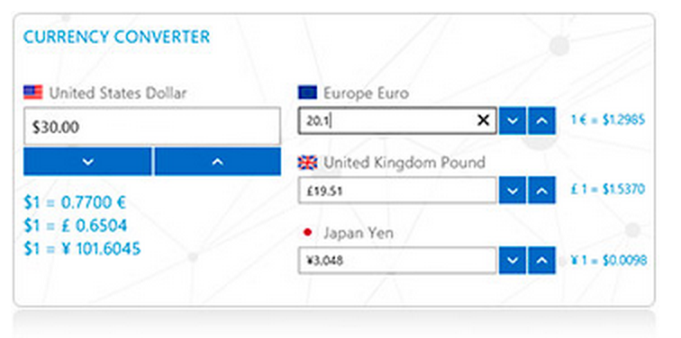
NumericBox
Windows 8.1 exclusive
Smart numeric input control
Various value formats – numeric/percentage/currency
User has precise control of numeric inputs – increment/decrement options
Predefined Small or Large steps
Product page: http://www.telerik.com/windows­8/numericbox­xaml

Slide 31
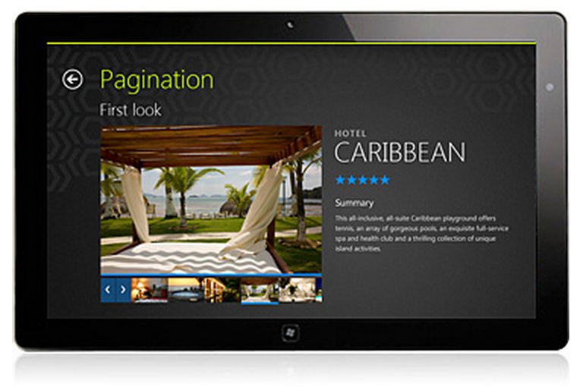
Pagination
Windows 8.1 exclusive
Simplified navigation between pages
Stylish, but fast intuitive movement between pages
Default navigation buttons
Page previews through thumbnails
Useful for master-detail scenarios
Product page: http://www.telerik.com/windows­8/pagination­xaml

Slide 32
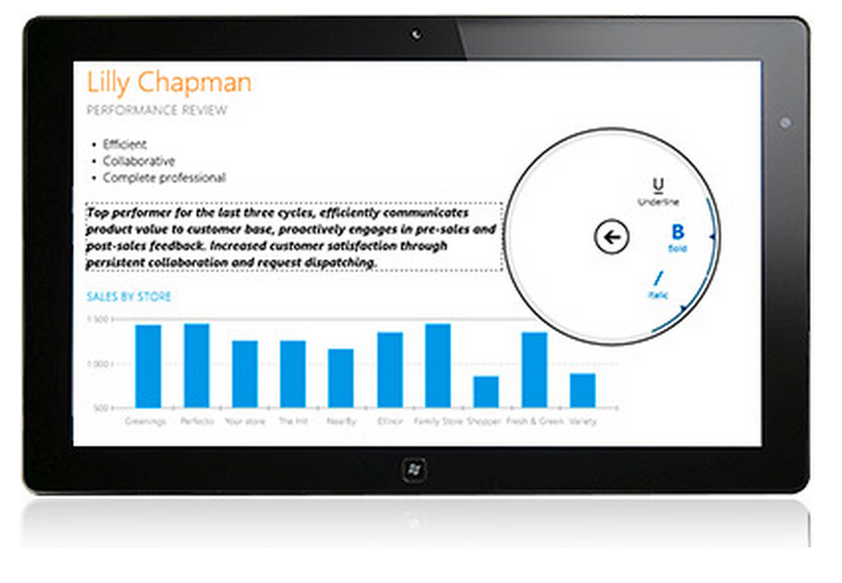
RadialMenu
Windows 8.1 exclusive
Custom-made circular context menu
Intuitive user interactions – touch ready
Convenient UX for hierarchy of items
Fully customizable appearance
Nested items - commands grouped into levels
Toggle behavior on item selection
Product page: http://www.telerik.com/windows­8/radialmenu­xaml

Slide 33
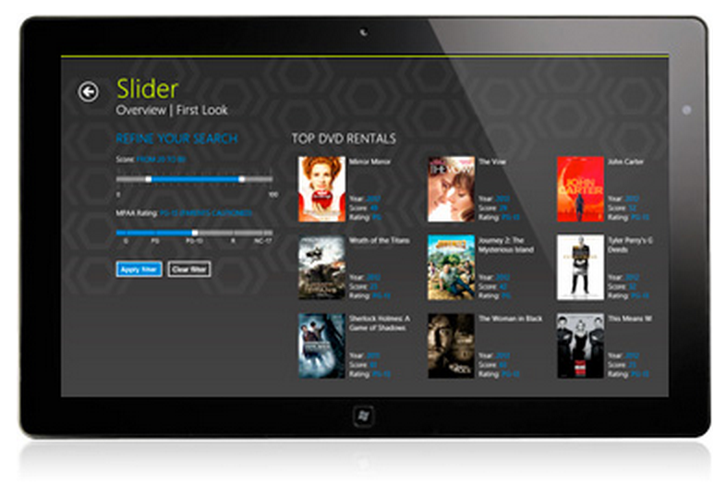
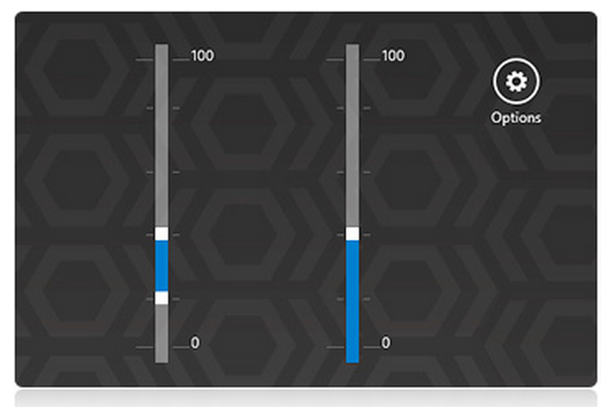
Slider
Windows 8.1 exclusive
Visual slider for thumb-control
Easy adjustment of values within defined range
Support for two thumbs
Horizontal/Vertical orientations, with tooltips
Tick frequency through predefined steps
Product page: http://www.telerik.com/windows­8/slider­xaml

Slide 34
Resources & Notes
Recap: Brand new official product suite – Telerik UI for Windows Universal
Engineered to build next-gen amazing X-Plat Windows apps!
Product home: http://www.telerik.com/windows­universal­ui
UI for Windows 8 being rolled into UI for Windows Universal
UI for Windows Phone stays as is .. More controls will migrate to Universal suite
UI for Windows 8 (HTML) on hold & as is
Telerik Developer Network: http://developer.telerik.com/

Slide 35
Introducing - Telerik UI for Windows Universal
Questions?
Samidip Basu Developer Advocate | Telerik Inc. | www.telerik.com
E: Sam.Basu@Telerik.com |T: @samidip | W: http://samidipbasu.com
Why build for only Windows, when you can go true X-Plat?

