Slide 1
Build Cross-Platform Mobile Apps Using Visual Studio
AND
A Telerik webinar by Jeffrey T. Fritz -- @csharpfritz
March 27, 2014

Slide 2
Now Presenting – Jeffrey T. Fritz
Telerik Developer Advocate – ASP.NET
Microsoft MVP – ASP.NET / IIS
ASPInsider
Pluralsight Author
INETA Community Champion
Speaker at many user groups and conferences such as:
Tech Ed North America
DevIntersection
FalafelCon
Code Camp NYC, Philly Code Camp, Orlando Code Camp, CodeStock
Appears on podcasts:
.NET Rocks, The Tablet Show, Yet Another Podcast

Slide 3
Telerik Platform at a Glance
Everything you need to build applications for any screen

Slide 4
First, a look at the mobile landscape.

Slide 5
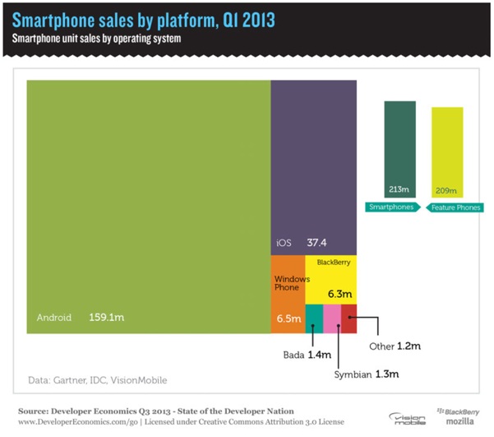

Slide 6
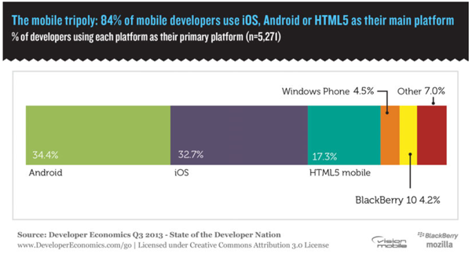

Slide 7
Platform complexity
WWW
Objective-C
Java
XAML, C#
HTML, CSS, JS
Xcode
Eclipse
Visual Studio
Multiple
Mac OS X
Windows
Multiple
Notes:
Primary Message: …and multiple operating systems.

Slide 8
Mobile Options
Native
Mobile Web
“Hybrid” Mobile

Slide 9
Native
Single platform
Objective C, Java, C#
High Dev. Cost
Native APIs
Advanced graphics
App Store Distribution
Hybrid
Multiple platforms
HTML, JS, CSS
Reasonable Dev. Cost
Native APIs*
Moderate graphics
App Store Distribution
Mobile Web
Multiple platforms
HTML, JS, CSS
Reasonable Dev. Cost
Limited APIs
Limited graphics
Web Distribution

Slide 10
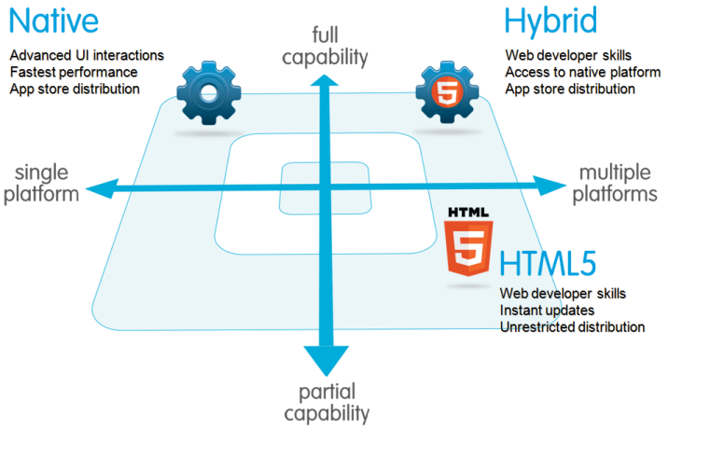
http://wiki.developerforce.com

Slide 11
“Developers most often use several cross-platform tools; on average CPT developers will use 1.91 CPTs….”
– VisionMobile Developer Economics 2013 Report

Slide 12
“Moreover, we found that one in four developers will use more than three cross- platform tools.”
– VisionMobile Developer Economics 2013 Report

Slide 13
We can do better than this.

Slide 14
Our solution || hybrid mobile development in the cloud

Slide 15
Telerik AppBuilder
Leverages PhoneGap/Cordova
HTML + JavaScript + CSS
Access to Native APIs
Runs in native application container

Slide 16
Compiler as a Service
Normally – you have to manage SDKs, native container and web assets & building
We build it for you & give you an installer for your target(s)
You just focus on writing HTML, JavaScript & CSS

Slide 17
In other words – we change this:
PC
<…>
SDKs
Compilers
Etc.
MAC
<…>
Notes:
Primary Message: Traditional IDEs are incompatible with the needs of cross platform development.

Slide 18
Into this:
<…>
NEW!
Notes:
Primary Message: The cloud offers a solution to the platform affinity between development and target environments.

Slide 19
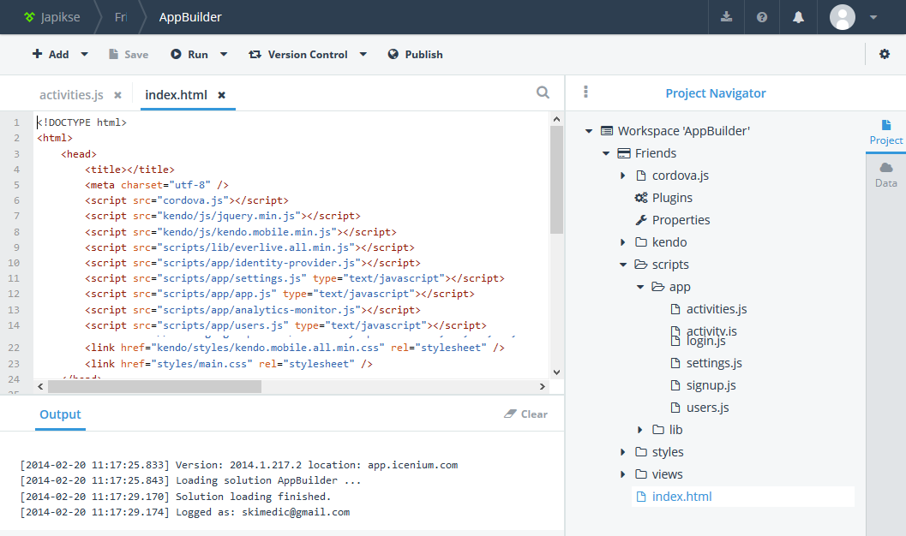
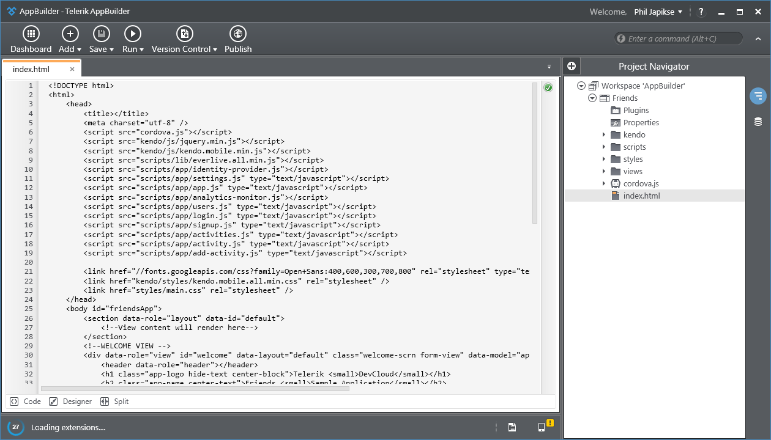
IDEs
In-Browser Client (part of the Telerik Platform)
Windows Client
Visual Studio Extension (2010->2013)

Slide 20
Telerik Platform In-Browser Client for AppBuilder
Runs in all major browsers
Common IDE features
Intellisense
Code completion
Syntax highlighting
Connects to any accessible git repository
Has an in-browser PhoneGap/Cordova emulator (for testing)

Slide 21
Windows Client for AppBuilder
Windows Client
Integrates with any accessible git repository
Common IDE Features & more
Uses Webkit-based Simulator with lots of debugging functionality
LiveSync – changes instantly reflected in devices & simulator

Slide 22
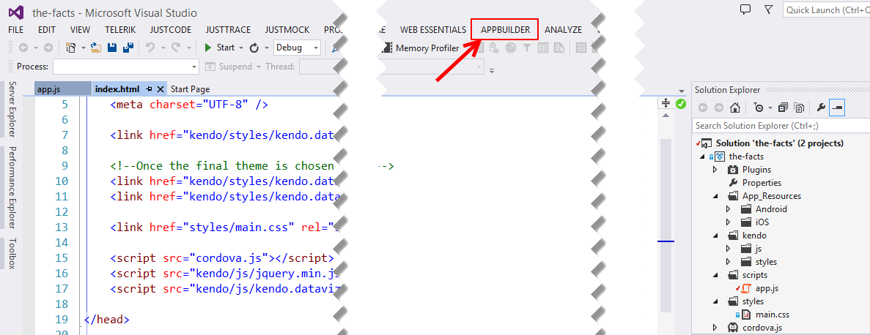
Visual Studio Extension
Enables you to write hybrid mobile apps using VS 2010-2013
You control version control (& other development tool-chain options)
Uploads code to AppBuilder’s build services (you get an installer back)

Slide 23
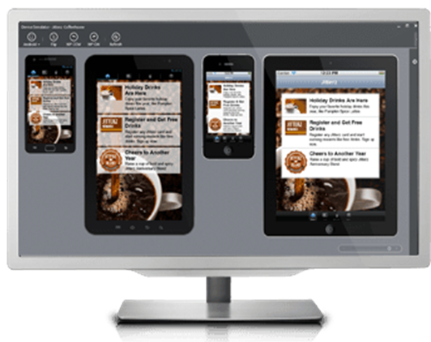
Simulator & Debugging
All three IDE options come with a Simulator
Platform Client
Uses browser tools
PhoneGap emulator
Windows Client/Visual Studio
Uses WebKit-based simulator
Powerful debugging & profiling tools

Slide 24
QR Code Deployment
Deploy wirelessly to any device
Companion App - provision-less deployment to iOS
Deploy to Android and provisioned iOS via QR Code also

Slide 25
Publish straight to Apple & Google app stores
(You don’t need a Mac) ☺

Slide 26
Making Mobile Apps Even Better
Kendo UI Mobile
Included with AppBuilder!
Native theming possible
Great performance
UI Widgets + App Framework
Telerik Backend Services
“Backend-as-a-Service”
JavaScript, .NET, iOS and HTTP client APIs
Telerik Analytics
App analytics
Monitor performance and feature usage

Slide 27
Beware! Roadmap Items Ahead!
Data Link for MS SQL
No need to write and host your own SDK for your data
Pipeline to expose your secure internal data without synchronizing with Telerik Backend Services
Lightweight and Optimized for Mobile
Visual Studio Integration with Backend Services
Browse and manage service configuration within Visual Studio
Windows Phone 8 Support for the AppBuilder Companion App
More QR Code loading goodness!
Cloud Code Debugger for Visual Studio
Debug custom JavaScript code running on Backend Services

Slide 28
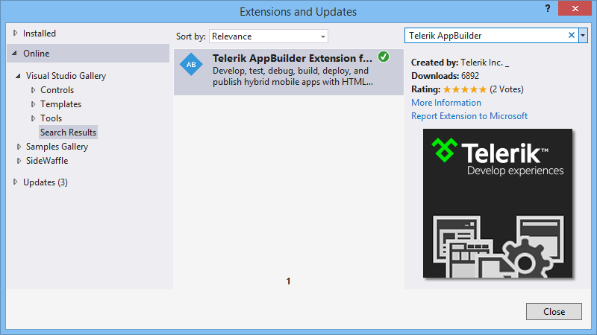
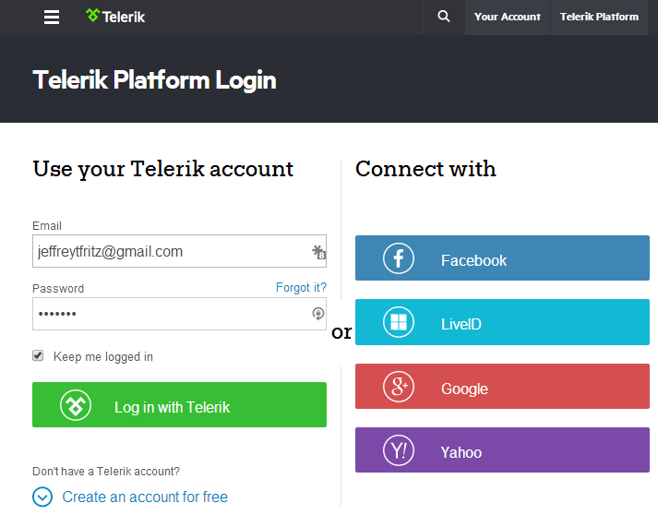
Get Started Today!
Go to http://platform.telerik.com to sign up
Download SDKs from the Platform website for
.NET
JavaScript
In Visual Studio
Tools – Extensions and Updates
Search for Telerik AppBuilder
On your iPhone or iPad
Add the Telerik AppBuilder App
Download from:
http://bit.ly/iOSAppBuilder
http://bit.ly/iOSAppBuilder

Slide 29
Contact me…
fritz@telerik.com
www.csharpfritz.com
blogs.Telerik.com/jefffritz
www.twitter.com/csharpfritz
AND

