Slide 1
AJAX controls update
Jeffrey T. Fritz
blogs.telerik.com/jefffritz
csharpfritz.com
twitter.com/csharpfritz
Jeff.fritz@telerik.com

Slide 2
Webinar Week Sweepstakes
Just for fun…
10 attendees from each webinar will be randomly selected to win*:
A Telerik Ninja T-shirt
A $50 Gift Certificate to ThinkGeek.com
Winners we hope you’ll share pics of what you get from ThinkGeek! ☺
We’ll announce winners on Twitter and Facebook and you’ll be notified via the email with which you registered. Good luck!
*See Terms & Conditions for details:
http://www.telerik.com/developer-productivity-tools/whats-new/Q12013-Webinar-Week-Terms-and-Conditions

Slide 3
Schedule
March 4th– Monday | 11:00am EDT (30min) | Enhance Your WinForms LOB Applications with PDF Viewer, PivotGrid, and Reporting
March 4th– Monday | 11:30am EDT (30min) | Impress Your End-Users with New Visualizations in Telerik Reporting. Manage Large Data Models with OpenAccess.
March 5th– Tuesday | 11:00am EDT (60min) | Get the Most Out of AJAX Web Development with PivotGrid, Grid Model Binding Support, and Integration with SharePoint 2013
March 5th– Tuesday | 12:00am EDT (30min) | Skip the JavaScript! Build awesome HTML5 apps with Kendo UI’s MVC server wrappers
March 6th– Wednesday | 11:00am EDT (60min) | Dramatically Improve Your Next XAML Enterprise Application with PivotGrid, Spreadsheet, and Telerik Reporting
March 7th– Thursday | 11:00am EDT (60min) | Amp Up Your Visual Studio Productivity with the New Features in JustCode, JustMock, JustTrace, and JustDecompile
March 8th– Friday | 11:00am EDT (60min) | Bring Power, Convenience, and Meaningful Display of Data to Windows 8 UI using the All-New Grid, AutoCompleteBox, and New Features in Chart
March 8th– Friday | 12:00am EDT (30min) | Develop Engaging Consumer and Enterprise Apps with the Most Recent Additions to Windows Phone 8 Controls

Slide 4
Today’s webinar is brought to you by…
Telerik DevCraft Complete edition comes with Just Code and 11 other products that give you the best tools with the familiar look and feel of Telerik on EVERY .Net platform.
All of the code demonstrations today showcase the
JustCode productivity enhancement tool. The samples
that access a database utilize OpenAccess, our
FREE data access solution.

Slide 5
Agenda
New controls!
New skins!
New features!
Model binding support
Feature updates

Slide 6
DropDownList Control
Lightweight control with server AND client side bindings – smaller and faster than the RadComboBox
Mobile Support
Single-select ONLY, No filtering, Limited to the list content
Server and client-side templating
DEMO

Slide 7
DropDownTree
Purpose: Selection from a hierarchical list
Templates for server or client side binding
Multi-select options
DEMO

Slide 8
SearchBox
DataBinding to any datasource – client or server
Client and server templates
Client and server events
Keyboard navigation
Autocomplete
DEMO

Slide 9
PivotGrid
OLAP Support
Floating menu
Data templates, Header templates
Quick to assemble and let your executives tinker with
Rich APIs
DEMO!

Slide 10
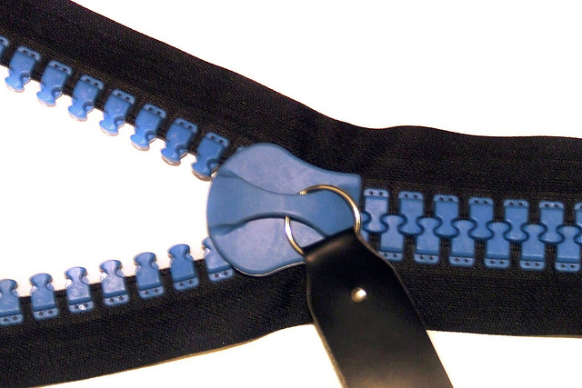
ZipLibrary
Load data from
existing ZIP files
Compress and Decompress streams
Combine with the AsyncFileUpload to save time and drive space

Slide 11
Persistence Framework
Persist AJAX control properties between requests to a StorageProvider using a StateSerializer
StorageProviders: AppData, Cookie
Released in BETA
Works with any control with Advanced configuration
Automatic configuration of some controls with most common properties

Slide 12
New Control Features
Image Editor – Client side filters + Editing
Light rendering mode
HtmlChart – 2 new chart modes
.Net 4.5 Model Binding Support in Grid, TreeList, ListView, PivotGrid, TreeView, ComboBox
RadBarCode export as image and PDF
Pause, Resume AsyncFileUpload
DEMO

Slide 13
SharePoint 2013 Support
All controls are now certified to be SharePoint 2013 compliant
4 Pre-built web parts you can use in your on-premesis SharePoint installation
Updated with the latest features from their ASP.Net equivalents
Editor
Grid
ListView
Scheduler

Slide 14
Thanks for attending
Download ASP.Net AJAX controls at www.telerik.com
www.telerik.com/products/aspnet-ajax/whats-new.aspx
blogs.telerik.com/aspnet-ajax
blogs.telerik.com/jefffritz
csharpfritz.com @csharpfritz
April 9 – Pittsburgh.Net May 4 – KCDC – Kansas City
April 17 – Philly.Net May 11 – Philly Code Camp
April 23 – CapArea.Net May 16 – Arizona Day with Scott Guthrie
June 3 – 6 – Tech Ed North America – New Orleans
Look for more content from me in MSDN Magazine + Dot Net Rocks

