Slide 1
RadControls for Windows 8
2013 Q1 Release
Notes:
Phil

Slide 2
Roadmap for Today
Why Windows 8 Store Apps
Review of 2012 Q3
New Controls & Features
Demos – XAML/HTML
Resources / Q&A
Notes:
Phil

Slide 3
Schedule
March 4th– Monday | 11:00am EDT (30min) | Enhance Your WinForms LOB Applications with PDF Viewer, PivotGrid, and Reporting
March 4th– Monday | 11:30am EDT (30min) | Impress Your End-Users with New Visualizations in Telerik Reporting. Manage Large Data Models with OpenAccess.
March 5th– Tuesday | 11:00am EDT (60min) | Get the Most Out of AJAX Web Development with PivotGrid, Grid Model Binding Support, and Integration with SharePoint 2013
March 5th– Tuesday | 12:00pm EDT (30min) | Skip the JavaScript! Build awesome HTML5 apps with Kendo UI’s MVC server wrappers
March 6th– Wednesday | 11:00am EDT (60min) | Dramatically Improve Your Next XAML Enterprise Application with PivotGrid, Spreadsheet, and Telerik Reporting
March 7th– Thursday | 11:00am EDT (60min) | Amp Up Your Visual Studio Productivity with the New Features in JustCode, JustMock, JustTrace, and JustDecompile
March 8th– Friday | 11:00am EDT (60min) | Bring Power, Convenience, and Meaningful Display of Data to Windows 8 UI using the All-New Grid, AutoCompleteBox, and New Features in Chart
March 8th– Friday | 12:00pm EDT (30min) | Develop Engaging Consumer and Enterprise Apps with the Most Recent Additions to Windows Phone 8 Controls
Notes:
Phil

Slide 4
Webinar Week Sweepstakes
Just for fun…
10 attendees from each webinar will be randomly selected to win*:
A Telerik Ninja T-shirt
A $50 Gift Certificate to ThinkGeek.com
Winners we hope you’ll share pics of what you get from ThinkGeek! ☺
We’ll announce winners on Twitter and Facebook and you’ll be notified via the email with which you registered. Good luck!
*See Terms & Conditions for details:
http://www.telerik.com/developer-productivity-tools/whats-new/Q12013-Webinar-Week-Terms-and-Conditions
Notes:
Phil

Slide 5
Introduction
Jesse Liberty
Author, Speaker, Blogger
XAML Evangelist, Telerik
Email: jesse.liberty@Telerik.com
Twitter: @JesseLiberty
Blog: http://JesseLiberty.com
Blog: http://blogs.telerik.com/jesseliberty
Notes:
Jesse

Slide 6
Introduction
Phil Japikse
Microsoft MVP, MCSD, MCDBA, CSM, CSP
Developer Evangelist, Telerik
Email: phil@telerik.com
Twitter: @skimedic
Blog: http://www.skimedic.com/blog
Blog: http://blogs.telerik.com/skimedic
Notes:
Phil

Slide 7
Introduction
Iris Classon,
MCTS, MCPD, MEET Member
XAML Evangelist, Telerik
Email: iris.classon@Telerik.com
Twitter: @IrisClasson
Blog: http://www.IrisClasson.com
Notes:
Iris

Slide 8
Why Build Windows 8 Store Apps?
Notes:
Iris

Slide 9
Why Build Windows 8 Store Apps now?
Next Generation OS
Age of the slate / tablet PC is now.
Use a language you already know.
Monetize
Notes:
Iris

Slide 10
Pricing
Notes:
Iris

Slide 11
2012 Q3 Release Recap
Notes:
Iris

Slide 12
2012 Q3 Release
2013 Q1 Release
Controls
 | Charts | Numeric Box
 | Bullet Graph | Drop Down List
 | Gauges | Slider
 | Date/Time Pickers
 | Pagination | ComboBox
 | Hub Tiles
- New Charts
Auto-complete
Auto-complete
RadGrid
Notes:
Jesse

Slide 13
What’s new in XAML
RadGrid
RadAutoCompleteBox
RadChart Features
Empty Values
Annotations
Notes:
Jesse

Slide 14
AutoComplete
Notes:
Jesse

Slide 15
AutoComplete: Inline Suggestions
Notes:
Jesse

Slide 16
Charts - Annotations
Notes:
Jesse

Slide 17
Charts: Empty Value
Notes:
Jesse

Slide 18
Charts: Multi-Axis
Notes:
Jesse

Slide 19
Charts: Stock Series
Notes:
Jesse

Slide 20
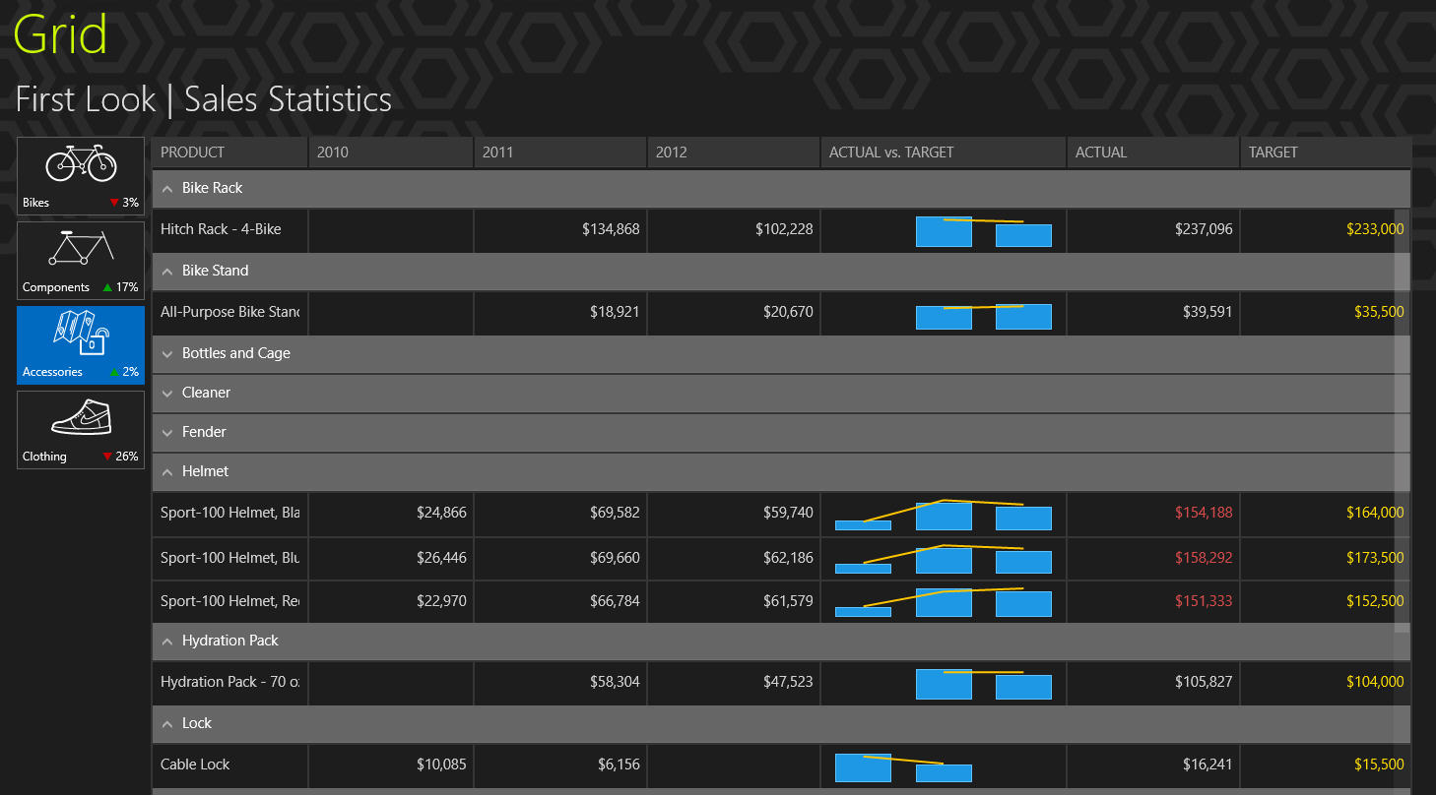
Grid
RadGrid
RadAutoCompleteBox
RadChart Features
Empty Values
Annotations
Notes:
Jesse

Slide 21
Demos – XAML
Notes:
Jesse - demo qsf and then drop in a grid from scratch and modify the grid to show column control

Slide 22
What’s new in HTML
RadGrid
RadChart Features
Financial Indicators
Notes:
Phil

Slide 23
Chart: Stock Series
Notes:
Jesse

Slide 24
Grid
RadGrid
RadAutoCompleteBox
RadChart Features
Empty Values
Annotations
Notes:
Jesse

Slide 25
Demos – HTML
Notes:
Phil

Slide 26
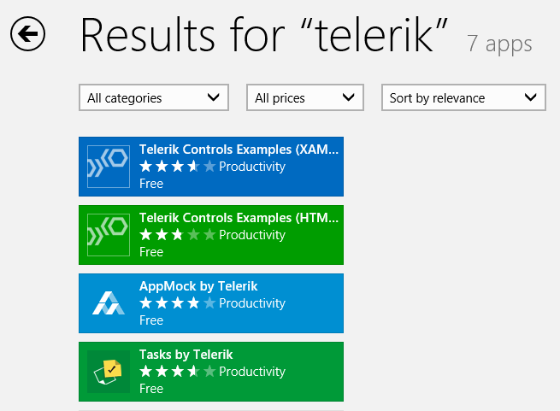
Telerik Examples in Windows Store
Notes:
Phil

Slide 27
Resources
Windows Store
Search for Telerik
Telerik
http://www.telerik.com/
Documentation / Demos / Forums, etc.
http://www.telerik.com/win8
Notes:
Phil

Slide 28
The DevCraft Collection
Packed with 11 great products, including:
RadControls for Windows 8 XAML/HTML
JustCode
DevCraft costs less than buying individually
Notes:
Story Wrap-Up: Don’t forget that you get both and much more with DevCraft Complete for a deeply discounted price. You can also upgrade to DevCraft Ultimate to add all of the features included with Complete plus additional support and maintenance options.

Slide 29
Delivering More Than Expected

Slide 30
JustCode Template Support
C#
VB.NET
JavaScript
HTML
CSS
LESS

Slide 31
Demo – JustCode and WinJS

Slide 32
Q & A
Download RadControls for Windows 8 Store Applications at
http://www.telerik.com/win8
Language | Email | Twitter
XAML/.NET | Jesse.Liberty@telerik.com | @JesseLiberty
WinJS/HTML | Phil@telerik.com | @skimedic
XAML/.NET | Iris.Classon@Telerik.com | @irisclasson
Notes:
Phil

